Slide 1



End-to-End Machine Learning
Project
PG Certificate Course on AI/ML and Data Engineering
by IIT Roorkee

Slide 2
Project
End-to-End Machine Learning Project

Slide 3
Objective
In this session
We’ll walk you through with the complete cycle of a
Machine Learning project
It’s okay if you do not understand few code snippets
We’ll cover them in details as we go forward in the course

Slide 4
Objective
Let’s Start

Slide 5
Prepare the Environment
Open Jupyter in CloudxLab’s “My Lab”
Open New Terminal
Clone the repository if not yet cloned
git clone https://github.com/cloudxlab/iitr-deep-learning-spl-tf2.git
Else, update the repository
cd iitr-deep-learning-spl-tf2 && git pull origin master
Notebook for this project is located at
end_to_end_machine_learning_project.ipynb
Goto Files

Slide 6
Checklist for Machine Learning Projects
Frame the problem and look at the big picture
Get the data
Explore the data to gain insights
Prepare the data for Machine Learning algorithms
Explore many different models and short-list the best ones
Fine-tune model
Present the solution
Launch, monitor, and maintain the system

Slide 7
End-to-End Machine Learning Project
Build a model of housing prices in California using the California census data

Slide 8
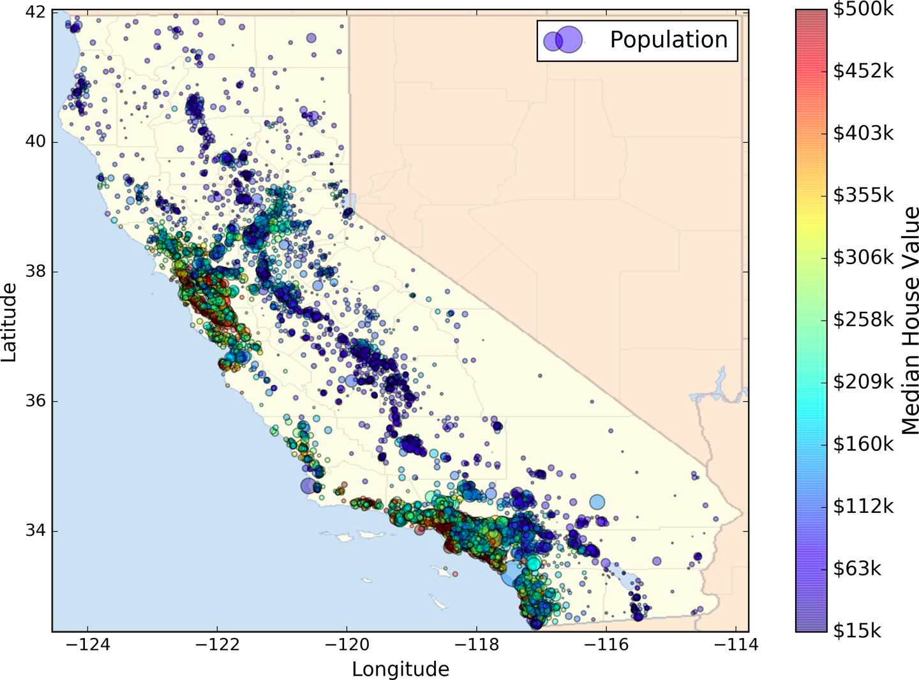
End-to-End Machine Learning Project
Dataset is based on data from the 1990 California census
Circle Size: Population, Price: Blue to Red

Slide 9
Let’s Have a Look at Data
>>> import pandas as pd
>>> import os
>>> HOUSING_PATH = 'datasets/housing/'
>>> def load_housing_data(housing_path=HOUSING_PATH):
csv_path = os.path.join(housing_path, "housing.csv")
return pd.read_csv(csv_path)
>>> housing = load_housing_data()
>>> housing.head()
Run this in notebook

Slide 10
Checklist for Machine Learning Projects
Frame the problem and look at the big picture
Get the data
Explore the data to gain insights
Prepare the data for Machine Learning algorithms
Explore many different models and short-list the best ones
Fine-tune model
Present the solution
Launch, monitor, and maintain the system

Slide 11
Look at the Big Picture
Dataset has following attributes for each block group in California
Population
Median income
Median housing price
And more….

Slide 12
Look at the Big Picture
Block groups are the smallest geographical unit for which the US Census Bureau publishes sample data
A block group typically has a population of 600 to 3,000 people
Let’s call them districts

Slide 13
Look at the Big Picture
Our model should learn from this data and be able to predict the median housing price in any district

Slide 14
Frame the Problem - Questions?
What exactly is the business objective?
How does the company expect to use and benefit from this model?
Above questions helps in determining
How to frame the problem?
Which algorithm to select?
Performance measure to evaluate the model
Effort required to tweaking it

Slide 15
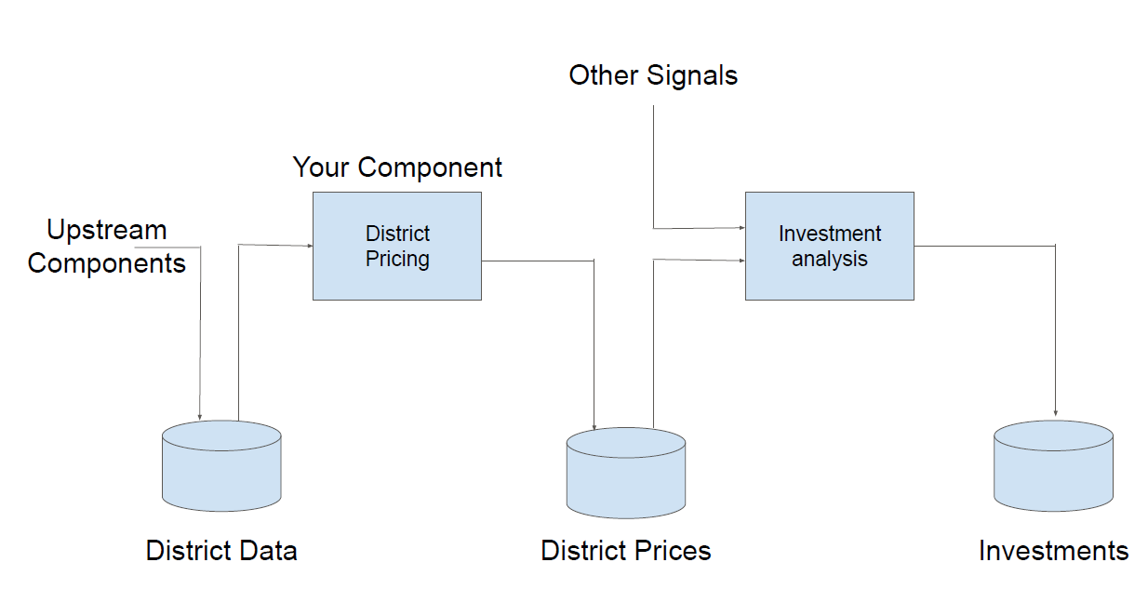
Frame the Problem - Answers
Other Signals
Your Component
District
Pricing
Investment
analysis
Upstream
Components
District Data
District Prices
Investments

Slide 16
Frame the Problem - Answers
Model’s output (a prediction of a district’s median housing price) will be fed
To another Machine Learning system
The system will determine
Whether it is worth investing in a given area or not
Getting this right it critical as
It directly affects the revenue

Slide 17
Frame the Problem - Current solution?
What the current solution looks like (if any)
It often gives a reference performance, as well as insights on how to solve the problem

Slide 18
Frame the Problem - Answer
District housing prices are currently estimated manually by experts
Team gathers up-to-date information about a district
Experts use complex rules to come up with an estimate
This is costly and time-consuming
Estimates are not great
Typical error rate is about 15%

Slide 19
Frame the Problem - Type of Learning?
Is this problem
Supervised, Unsupervised or Reinforcement Learning?
Classification task, Regression task, or something else?
Should we use batch learning or online learning techniques?

Slide 20
Frame the Problem - Answers
Supervised learning task
Data has labeled training examples
Each row in the data has the expected output(the district’s median housing price)
2. Regression task
We have to predict a value
Continuous valued output
System will use multiple features to make a prediction

Slide 21
Frame the Problem - Answers
3. Should we use batch learning or online learning techniques?
There is no continuous flow of data coming in the system
Data is small enough to fit in memory
Plain batch learning should do just fine

Slide 22
Frame the Problem - Answers
Select a Performance Measure - Root Mean Square Error
Let’s say we want to predict house value based on house area in square feet
We will use univariate linear regression
Since there is only one feature house area

Slide 23
Statistical Inference
Brief introduction to Statistical Inference

Slide 24
Types of Variables
All variables
Numerical
Categorical
Continuous
Discrete
Regular Categorical
Ordinal
Levels have an inherent ordering
Notes:
Continous - Can take any value between two limits.
Discrete - can take any value from a list of values. Integers.

Slide 25
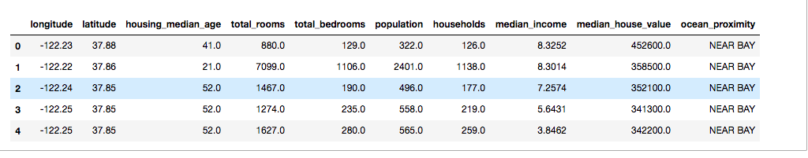
Types of Variables
Each Column is Variable
Each Row is observation
2. ??
??

Slide 26
Types of Variables
Each Column is Variable
Each Row is observation
Categorical
Numerical

Slide 27
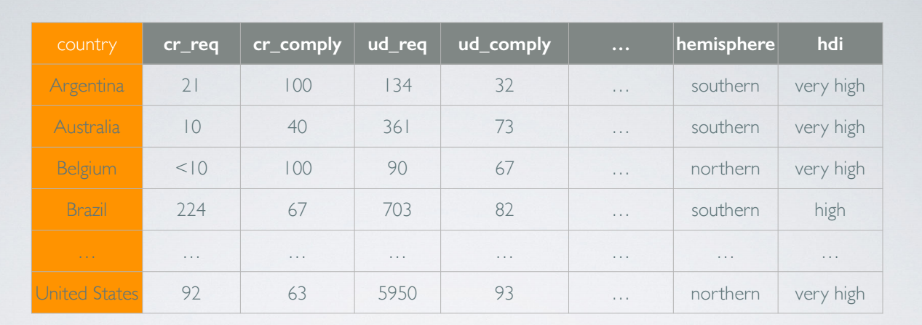
Types of Variables
Each Column is Variable
Each Row is observation
??
C. ??
D. ??
B. ??

Slide 28
Types of Variables
Each Column is Variable
Each Row is observation
Discrete numerical
Regular
Categorical
Ordinal
Categorical
Continuous Numerical

Slide 29


Random Process
In a random process we know what outcomes could happen,
but we don't know which particular outcome will happen.

Slide 30
Probability
P(A) = Probability of event A
0 ≤ P(A) ≤ 1

Slide 31
Probability - example
What is probability that the sum of pair of fair dice when rolled is 4?

Slide 32
Probability - example
What is probability that the sum of pair of fair dice when rolled is 4?
Total Possible ways in which the pair can be rolled = ??
Instances when the sum is 4 = ??
Probability = ??

Slide 33
Probability - example
What is probability that the sum of pair of fair dice when rolled is 4?
Total Possible ways in which the pair can be rolled = 6 X 6 = 36
Instances when the sum is 4 = ??
Probability = ??

Slide 34
Probability - example
What is probability that the sum of pair of fair dice when rolled is 4?
Total Possible ways in which the pair can be rolled = 6 X 6 = 36
Instances when the sum is 4 = (1,3), (3,1), (2,2) = 3
Probability = ??

Slide 35
Probability - example
What is probability that the sum of pair of fair dice when rolled is 4?
Total Possible ways in which the pair can be rolled = 6 X 6 = 36
Instances when the sum is 4 = (1,3), (3,1), (2,2) = 3
Probability = 3/36 = 1/12

Slide 36
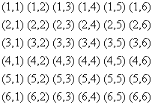
Probability - example

Slide 37
Random Variable
Random variable is a variable
Whose value is unknown or
A function that assigns values to each of an experiment's outcomes
Can be of multiple types
Depending upon the type of the quantity measured i.e.
Continuous
Discrete
Categorical etc

Slide 38
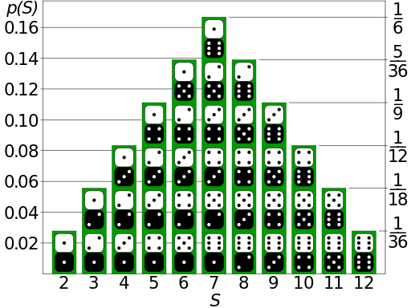
Probability Distribution
A probability distribution assigns a
Probability to each of the possible outcomes of
An random experiment, survey, or procedure of statistical inference
Picture Source: https://en.wikipedia.org/wiki/Probability_distribution

Slide 39
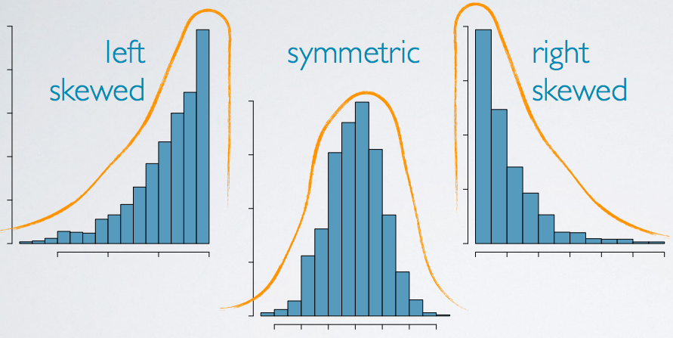
Normality - Skewness
Distributions are skewed to the side of the long tail

Slide 40
Measures of Central Tendencies
How do you define center of certain data?

Slide 41
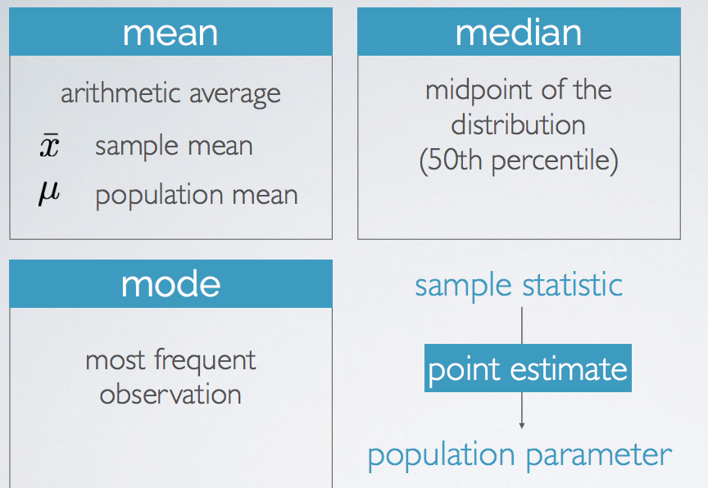
Measures of Central Tendencies
Notes:
If two numbers have same counts, both are reports as part of mode.

Slide 42
Measures of Central Tendencies
Which one would you choose?
Mean, Median or mode?

Slide 43
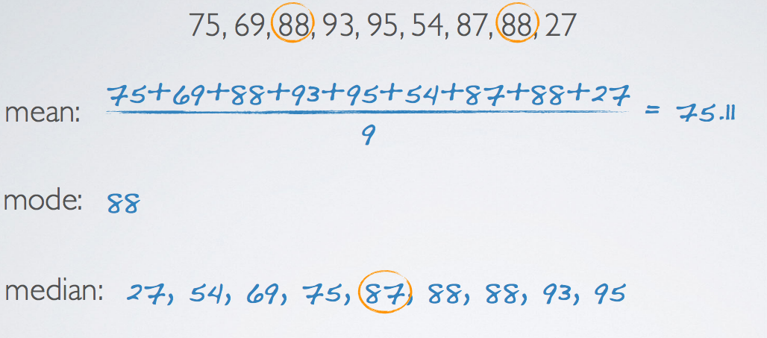
Measures of Central Tendencies

Slide 44
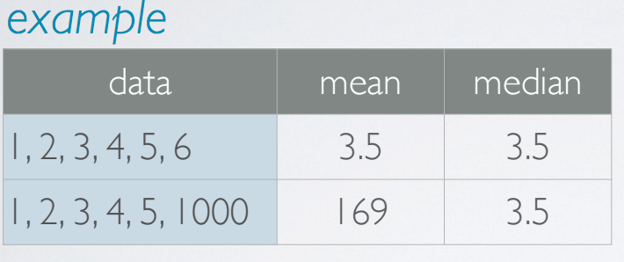
Robust Statistics
Measures on which extreme
observations have little effect
Notes:
If data is symmetric, then mean and SD are good representative of center and spread of the distribution, if data is skewed, IQR and median are good representative of center and skewed.

Slide 45
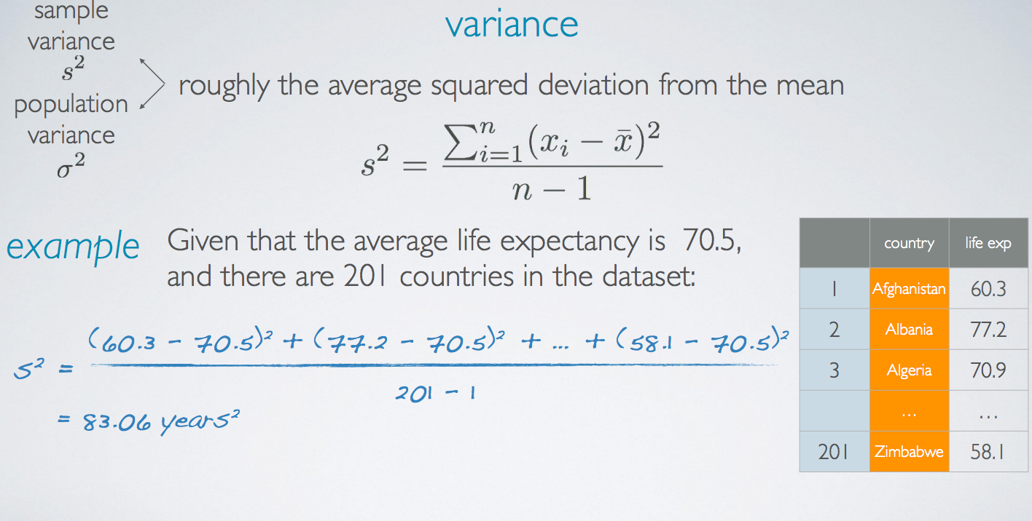
Measures of Spread

Slide 46
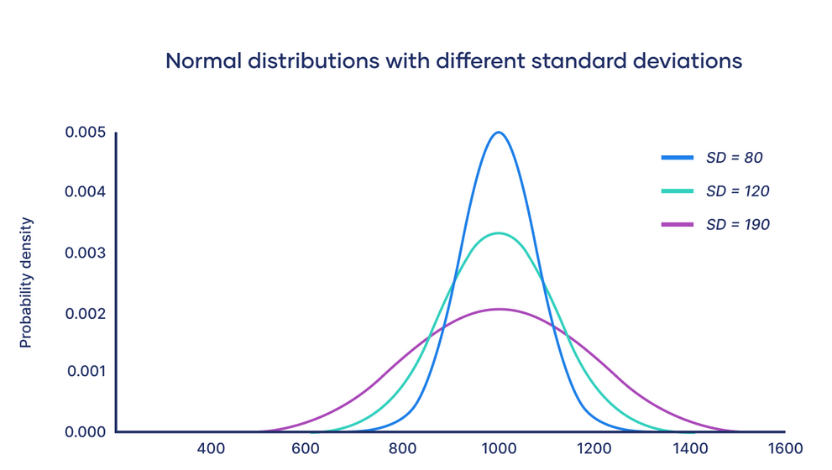
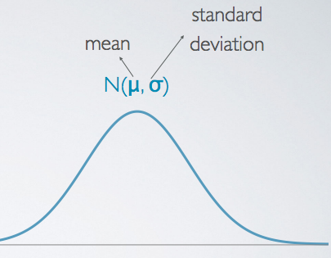
Normal Distribution
Notes:
import numpy as np
import matplotlib.pyplot as plt
count, bins, ignored = plt.hist(s, 30, normed=True)
plt.plot(bins, 1/(sigma * np.sqrt(2 * np.pi)) * np.exp( - (bins - mu)**2 / (2 * sigma**2) ), linewidth=2, color='r')
plt.show()
Or
https://docs.scipy.org/doc/scipy/reference/generated/scipy.stats.norm.html#scipy.stats.norm

Slide 47
Back to: End to End Project

Slide 48
Frame the Problem - Answers
Select a Performance Measure - Root Mean Square Error
Let’s say we want to predict house value based on house area in square feet
We will use simple linear regression
Since there is only one feature house area

Slide 49
Frame the Problem - Answers
House Value vs House Area - Actual Data
House Value (In $)
House Area (In Sq ft)

Slide 50
Frame the Problem - Answers
Fit a Line
House Value = W0 + W1 * House Area
House Value (In $)
House Area (In Sq ft)

Slide 51
Frame the Problem - Answers
Fit a Line
y₁ - Actual Value
y₁^ - Predicted Value
4
3
1
y₁
House Value (In $)
5
y₁^
2
House Area (In Sq ft)

Slide 52
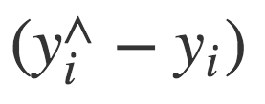
Frame the Problem - Answers
Error in Prediction
4
3
1
y₁
House Value (In $)
5
y₁^
2
House Area (In Sq ft)

Slide 53
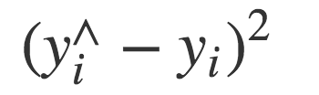
Frame the Problem - Answers
Squared Error
4
3
1
y₁
House Value (In $)
5
y₁^
2
House Area (In Sq ft)

Slide 54
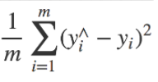
Frame the Problem - Answers
Mean Square Error
4
3
1
y₁
House Value (In $)
5
y₁^
2
House Area (In Sq ft)

Slide 55
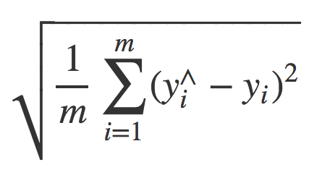
Frame the Problem - Answers
Root Mean Square Error (RMSE)
4
3
1
y₁
House Value (In $)
5
y₁^
2
House Area (In Sq ft)

Slide 56
Frame the Problem - Answers
Algorithm tries many lines to fit the data
Line A
Line B
Line C
House Value (In $)
House Area (In Sq ft)

Slide 57
Frame the Problem - Answers
Line of Best Fit - Line with a Minimum RMSE
Line A
Line of Best Fit
Line C
House Value (In $)
House Area (In Sq ft)

Slide 58
Frame the Problem - Answers
Line of Best Fit
House Value = W0 + W1 * House Area
Algorithm adjusts weights W0 and W1 to figure out line with minimum RMSE
House Value (In $)
House Area (In Sq ft)

Slide 59
Checklist for Machine Learning Projects
Frame the problem and look at the big picture
Get the data
Explore the data to gain insights
Prepare the data for Machine Learning algorithms
Explore many different models and short-list the best ones
Fine-tune model
Present the solution
Launch, monitor, and maintain the system

Slide 60
Get the Data
>>> import pandas as pd
>>> import os
>>> HOUSING_PATH = 'datasets/housing/'
>>> def load_housing_data(housing_path=HOUSING_PATH):
csv_path = os.path.join(housing_path, "housing.csv")
return pd.read_csv(csv_path)
>>> housing = load_housing_data()
>>> housing.head()
# Run this in notebook

Slide 61
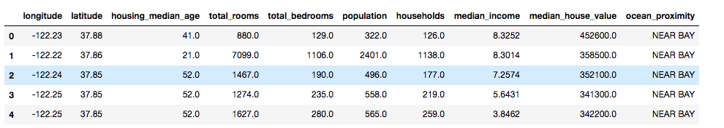
Get the Data
Check this in Notebook

Slide 62
Get the Data
Each row represents one district
There are 10 attributes:
longitude
latitude
housing_median_age
total_rooms
total_bedrooms
population
households
median_income
median_house_value
ocean_proximity

Slide 63
Get the Data
Plot histogram
Plot a histogram to get the feel of type of data we are dealing with
We can plot histogram only for numerical attributes

Slide 64
Get the Data
Plot histogram
>>> %matplotlib inline
>>> import matplotlib.pyplot as plt
>>> housing.hist(bins=50, figsize=(20,15))
>>> plt.show()

Slide 65
Get the Data
Plot histogram
Observations?

Slide 66
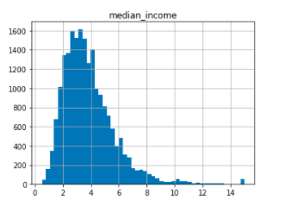
Things to Note in Histogram - One
Plot histogram

Slide 67
Things to Note in Histogram - One
Data is Capped
The median income attribute does not look like it is expressed in US dollars (USD)
After checking with the team that collected the data, you are told that the data has been scaled and capped at
15 (actually 15.0001) for higher median incomes, and
At 0.5 (actually 0.4999) for lower median incomes
Lesson: It is important to understand how your data was computed

Slide 68
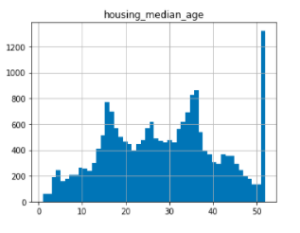
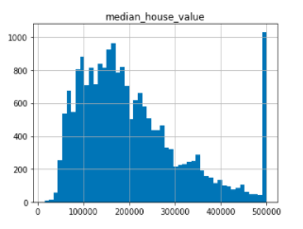
Things to Note in Histogram - Two
Plot histogram

Slide 69

Things to Note in Histogram - Two
The following are also capped
Median age - 50
Median house value - 500, 000
Machine Learning algorithms may learn that prices never go beyond that limit
Serious problem since median_house_value is the target attribute

Slide 70
Things to Note in Histogram - Two
How do we solve it?
Check with the team if this is a problem or not
If team says they need precise predictions even beyond $500,000 then
Collect proper labels for districts whose labels were capped
OR
Remove those labels from training as well as test dataset

Slide 71
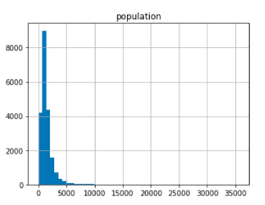
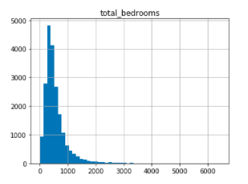
Things to Note in Histogram - Three
Plot histogram

Slide 72
Things to Note in Histogram - Three
Tail heavy histograms
Many histograms are tail heavy (skewed)
Harder for Machine Learning algorithms to detect patterns

Slide 73
Create a Test Set
Training and Test set
We generally split the data into
Training set - Contains 80% of the data
Test set - Contains remaining 20% of the data
We train the model on training set
And evaluate the performance of the model on test set

Slide 74
Create a Test Set
We’ve just seen the data and
Still have to learn a lot more about it to decide which algorithm to use
Why create a test set right now?

Slide 75
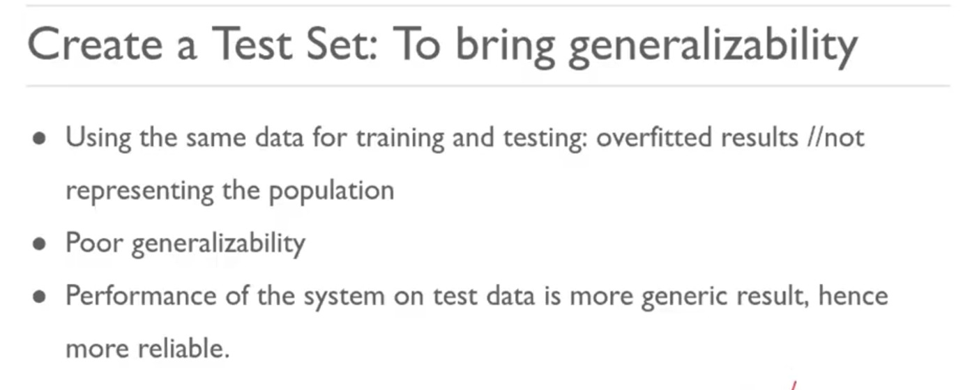
Create a Test Set

Slide 76
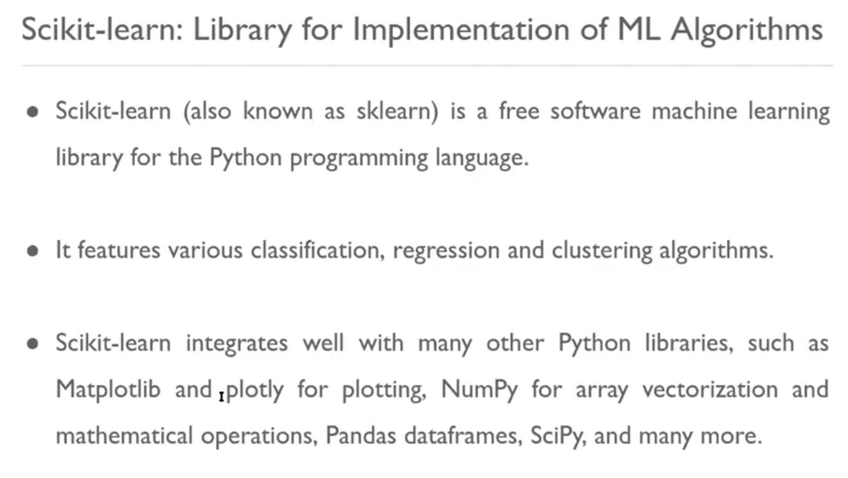

Slide 77
Create a Test Set
In this project, we will use
Scikit-learn train_test_split() function
To create test set
Over the next few slides, we will learn
How to create our own function
To create test set

Slide 78
Create a Test Set
Splitting Train and Test set
>>> np.random.seed(42)
>>> import numpy as np
def split_train_test(data, test_ratio):
shuffled_indices = np.random.permutation(len(data)) test_set_size = int(len(data) * test_ratio) test_indices = shuffled_indices[:test_set_size] train_indices = shuffled_indices[test_set_size:]
return data.iloc[train_indices], data.iloc[test_indices]

Slide 79
Create a Test Set
Splitting Train and Test set
Remember to pass a seed to np.random.permutation always
Seed is important because we want our model
To be trained and evaluated on same train and test set every time
Else on every run of split_train_test function
Train and test set will be different
Over time our machine learning model may see the whole dataset during training
Which we should to avoid

Slide 80
Create a Test Set
Splitting Train and Test set - Seed
Seed can be any number
Remember to pass same seed every time
To make sure same rows goes to train and test set
Everytime we run split_train_test function

Slide 81
Create a Test Set
Let’s run split_train_test in notebook
>>> train_set, test_set = split_train_test(housing, 0.2)
>>> print(len(train_set), "train +", len(test_set), "test")
Output -
16512 train + 4128 test

Slide 82
Create a Test Set
Using Scikit-learn for the same
Sklearn provides train_test_split function
Same as split_train_test defined earlier with two more features
There is random_state parameter which sets the random generator seed
We can pass it on a multiple datasets with an identical number of rows
split_train_test splits them on the same indices

Slide 83
Create a Test Set
Using Scikit-learn for the same
>>> from sklearn.model_selection import train_test_split
>>> train_set, test_set = train_test_split(housing, test_size=0.2, random_state=42)
Run it in notebook

Slide 84
Create a Test Set
Sampling Bias
Till now, we have considered pure random sampling methods
Random sampling methods work fine
If dataset is large enough
Else we are at risk of introducing significant sampling bias

Slide 85
Create a Test Set
Sampling Bias - Example
Let’s say a survey company in US decides to call 1,000 people to ask them few questions
What is the best approach to pick 1,000 people?

Slide 86
Create a Test Set
Sampling Bias - Example
Let’s say a survey company in US decides to call 1,000 people to ask them few questions
We can not just pick 1,000 people randomly

Slide 87
Create a Test Set
Sampling Bias - Important Point
Samples must be representative of the whole population

Slide 88

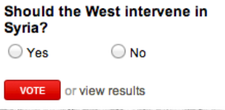

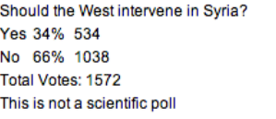
SAMPLING BIAS
Convenience sample
Individuals who are easily accessible are more likely to be included in the sample
Voluntary response
Occurs when the sample have strong opinions on the issue
Non-response
If only a (non-random) fraction of the randomly sampled people respond to a survey such that the sample is no longer representative of the population

Slide 89
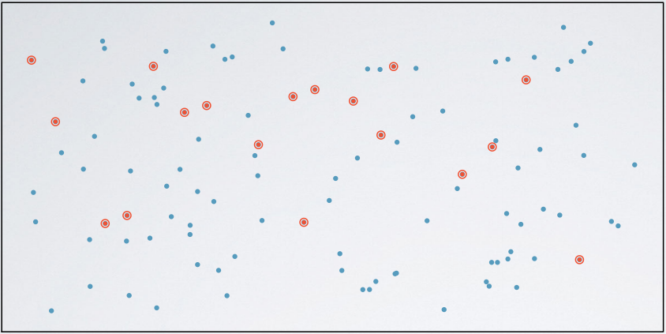
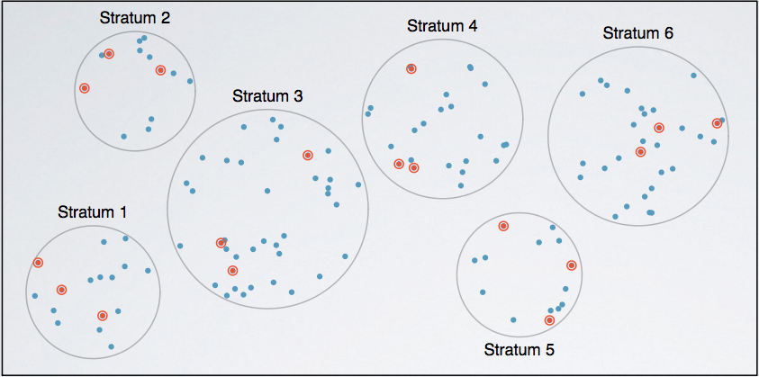
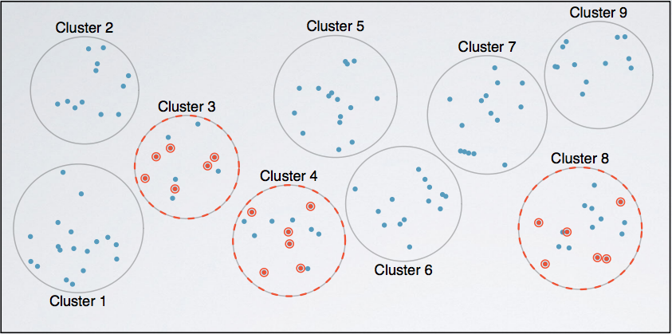
SAMPLING METHODS
Simple Random Sample (SRS)
Each case is equally likely to be selected
Stratified Sample
Divide the population into homogeneous strata, then randomly sample from within each stratum
Cluster Sample
Divide the population clusters, randomly sample a few clusters, then randomly sample from within these clusters

Slide 90
Create a Test Set
Sampling Bias - Example
US population is composed of
51.3% female
48.7% male

Slide 91
Create a Test Set
Stratified Sampling
A well-conducted survey on 1000 people in the US should
Try to maintain the ratio in the sample
513 female
487 male
This is called stratified sampling

Slide 92
Create a Test Set
Stratified Sampling
The population is divided into
Homogeneous subgroups called strata
And the right number of instances is
Sampled from each stratum
Else the survey results would be significantly biased

Slide 93
Create a Test Set
Median Income
Let’s say some experts advised us that
The median income is a very important attribute to predict median housing prices
Then the test set should be representative of
Various categories of median income

Slide 94
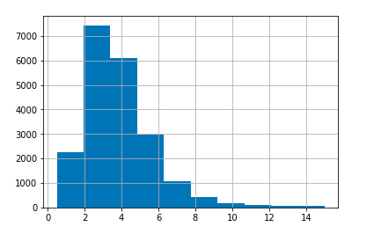
Create a Test Set
Create Histogram of Median Income
>>> housing["median_income"].hist()

Slide 95
Create a Test Set
Create Histogram of Median Income
Observations?

Slide 96
Create a Test Set
Create Histogram of Median Income
Most values are clustered around 2-5 thousand dollars

Slide 97
Create a Test Set
Create Histogram of Median Income
Some median income go beyond 6

Slide 98
Create a Test Set
Important Points
Since median income is important attribute to predict median housing prices
It is important to have sufficient number of instances
In the dataset for each stratum
This means that
We should not have too many strata
And each stratum should be large enough

Slide 99
Create a Test Set
Let’s limit the number of categories of median income

Slide 100
Create a Test Set
Limit the Categories in Median Income
Divide median income by 1.5 so that
We will not have too many strata
And each stratum will be large enough

Slide 101
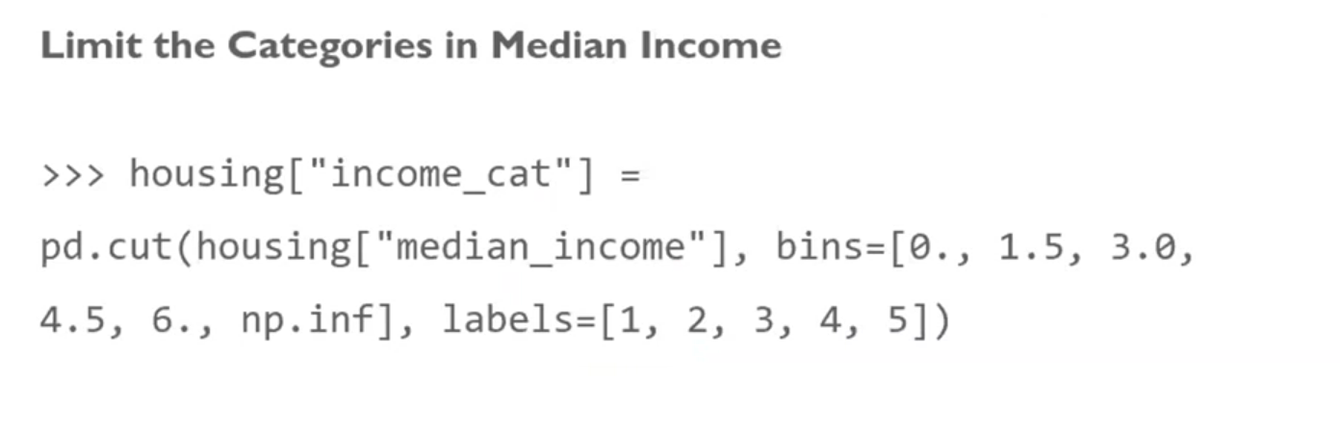
Create a Test Set
Limit the Categories in Median Income
>>> housing["income_cat"] = np.ceil(housing["median_income"] / 1.5)
>>> housing["income_cat"].where(housing["income_cat"] < 5, 5.0, inplace=True)
Run it in Notebook

Slide 102
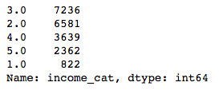
Create a Test Set
Limit the Categories in Median Income
>>> housing["income_cat"].value_counts()
Each stratum is large enough
Not too many strata

Slide 103
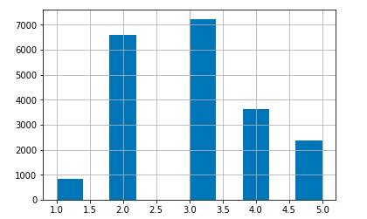
Create a Test Set
Limit the Categories in Median Income
>>> housing["income_cat"].hist()

Slide 104
Create a Test Set
Stratified Sampling - Sklearn StratifiedShuffleSplit Class
Now we are ready to do stratified sampling
Use Scikit-learn’s StratifiedShuffleSplit class

Slide 105
Create a Test Set
Stratified Sampling - Sklearn StratifiedShuffleSplit Class
>>> from sklearn.model_selection import StratifiedShuffleSplit
>>> split = StratifiedShuffleSplit(n_splits=1, test_size=0.2,
random_state=42)
>>> for train_index, test_index in split.split(housing, housing["income_cat"]):
strat_train_set = housing.loc[train_index]
strat_test_set = housing.loc[test_index]
Run it in notebook

Slide 106
Create a Test Set
Did Stratified Sampling work as expected?

Slide 107
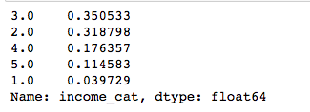
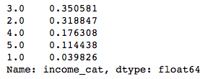
Create a Test Set
Did Stratified Sampling Work - Stratified Sampling vs Full dataset
>>> strat_test_set["income_cat"].value_counts() / len(strat_test_set)
Income category proportion in test set generated with stratified sampling
>>>
housing["income_cat"].value_counts() / len(housing)
Income category proportion in full dataset

Slide 108
Create a Test Set
Did Stratified Sampling Work?
Yes, it worked.
Income category proportions are almost identical between stratified sampling and full dataset

Slide 109
Create a Test Set
Let’s compare Stratified Sampling and Random Sampling

Slide 110
Create a Test Set
Compare Stratified Sampling and Random Sampling
>>> def income_cat_proportions(data):
return data["income_cat"].value_counts() / len(data)
>>> train_set, test_set = train_test_split(housing, test_size=0.2, random_state=42)
>>> compare_props = pd.DataFrame({
"Overall": income_cat_proportions(housing),
"Stratified": income_cat_proportions(strat_test_set),
"Random": income_cat_proportions(test_set),
}).sort_index()
>>> compare_props["Rand. %error"] = 100 * compare_props["Random"] / >>> compare_props["Overall"] - 100
>>> compare_props["Strat. %error"] = 100 * compare_props["Stratified"] / compare_props["Overall"] - 100

Slide 111
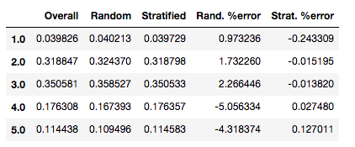
Create a Test Set
Compare Stratified Sampling and Random Sampling
Sampling bias comparison of stratified versus purely random sampling

Slide 112
Create a Test Set
Compare Stratified Sampling and Random Sampling
Observations?
Sampling bias comparison of stratified versus purely random sampling

Slide 113
Create a Test Set
Compare Stratified Sampling and Random Sampling
Test set generated using stratified sampling has income category proportion almost identical to those in full data set
Almost identical to full dataset
Income Category Proportions in Stratified Sampling

Slide 114
Create a Test Set
Compare Stratified Sampling and Random Sampling
Test set generated using stratified sampling has income category proportion is quite skewed
Quite skewed
Income Category Proportions in Purely Random Sampling

Slide 115
Create a Test Set
Compare Stratified Sampling and Random Sampling
Conclusion?

Slide 116
Create a Test Set
Compare Stratified Sampling and Random Sampling
Stratified Sampling gives better test set than Random Sampling

Slide 117
Create a Test Set
Remove income_cat attribute so that data is back to its original state
>>> for set in (strat_train_set, strat_test_set):
set.drop(["income_cat"], axis=1, inplace=True)
Run in Notebook

Slide 118
Create a Test Set
Why did we spend so much time in test set generation?

Slide 119
Create a Test Set
Test set generation is often neglected
But most important part of a Machine Learning project

Slide 120
Checklist for Machine Learning Projects
Frame the problem and look at the big picture
Get the data
Explore the data to gain insights (more from train data point of view)
Prepare the data for Machine Learning algorithms
Explore many different models and short-list the best ones
Fine-tune model
Present the solution
Launch, monitor, and maintain the system

Slide 121
Discover and Visualize the Data
Let’s understand the data in depth
Make sure
Test set is kept aside as the model has to be trained using training data
And explore only training set

Slide 122
Discover and Visualize the Data
If training set is large
Sample training set
To make manipulations easy and fast
Since our training set is small
We can directly work on full set

Slide 123
Discover and Visualize the Data
Create copy of training set first
So that we can play with it without harming the training set
>>> housing = strat_train_set.copy()
Run it on Notebook

Slide 124
Discover and Visualize the Data
Visualizing Geographical Data
Since there is geographical information of latitude and longitude
Create Scatterplot of all district to visualize the data
>>> housing.plot(kind="scatter", x="longitude", y="latitude")
Run it on Notebook

Slide 125
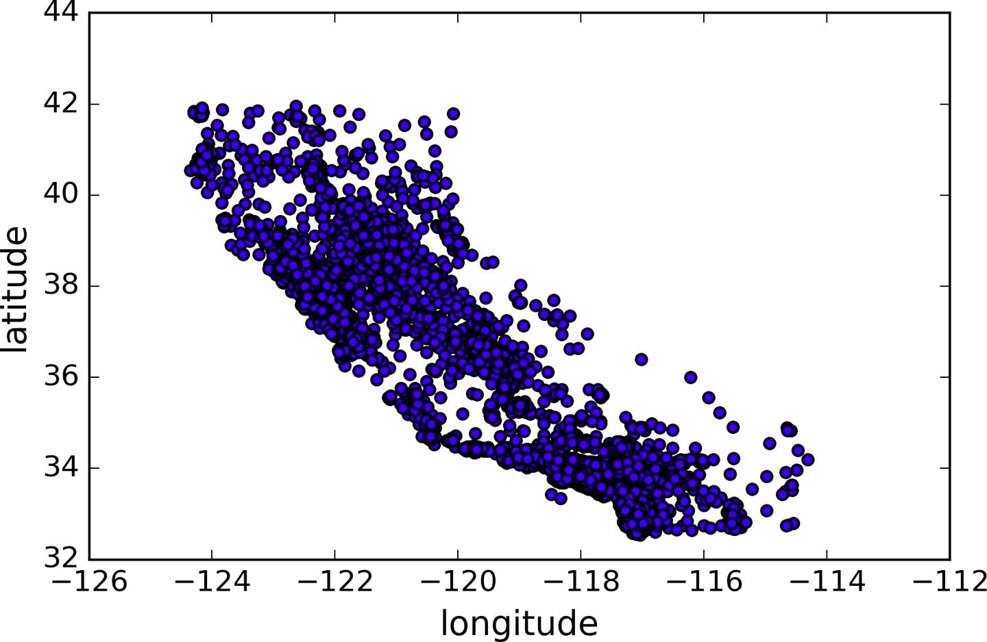
Discover and Visualize the Data
Visualizing Geographical Data

Slide 126
Discover and Visualize the Data
Problem?
Hard to see any particular pattern
We can not visualize the places with high density points

Slide 127
Discover and Visualize the Data
Solution
Setting the alpha option to 0.1
Makes it look like heat map
>>> housing.plot(kind="scatter", x="longitude", y="latitude", alpha=0.1)
Run it on Notebook

Slide 128
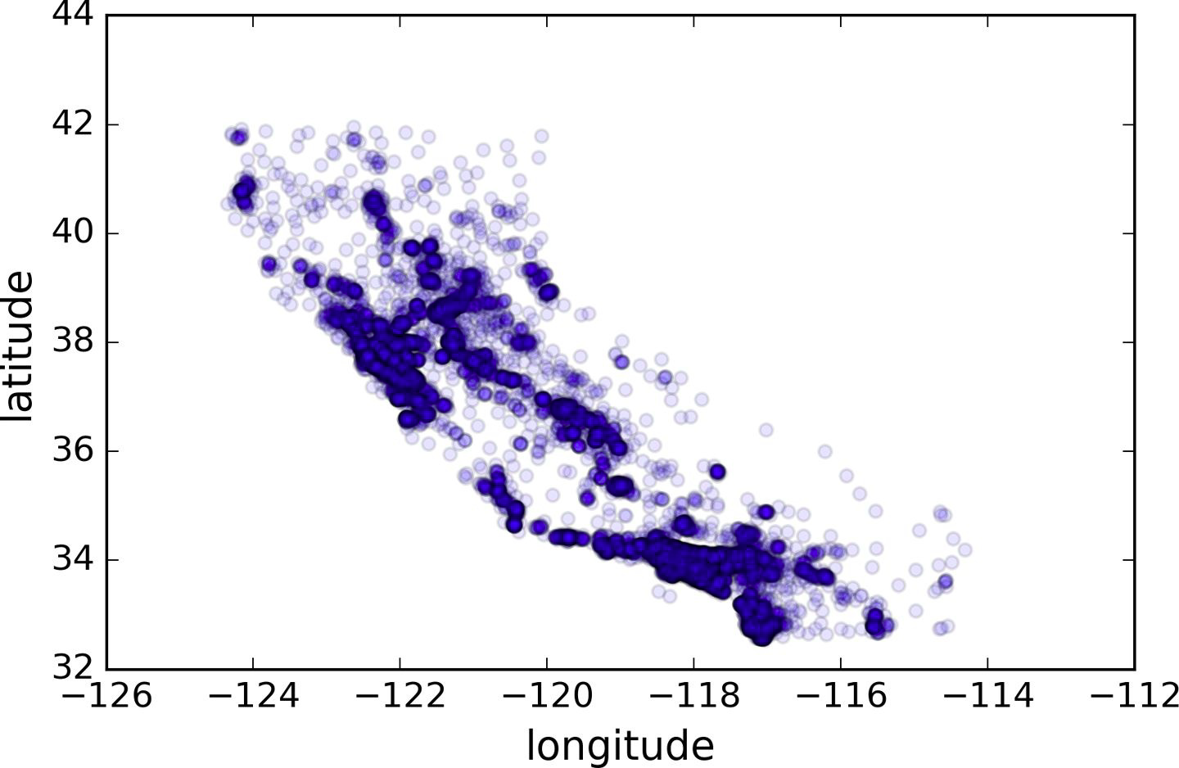
Discover and Visualize the Data
--- Areas of High Density
San Francisco
San Diego
Los Angeles

Slide 129
Discover and Visualize the Data
Let’s look into the patterns in depth
>>> housing.plot(kind="scatter", x="longitude", y="latitude", alpha=0.4,
s=housing["population"]/100, label="population", figsize=(10,7),
c="median_house_value", cmap=plt.get_cmap("jet"), colorbar=True,
sharex=False)
>>> plt.legend()
Run it on Notebook

Slide 130
Discover and Visualize the Data
Let’s look into the patterns in depth
The radius of each circle represents the district’s population (option s)
The color represents the price (option c).
We are using a predefined color map (option cmap)
Called jet
Which ranges from blue (low values)
To red (high prices)

Slide 131
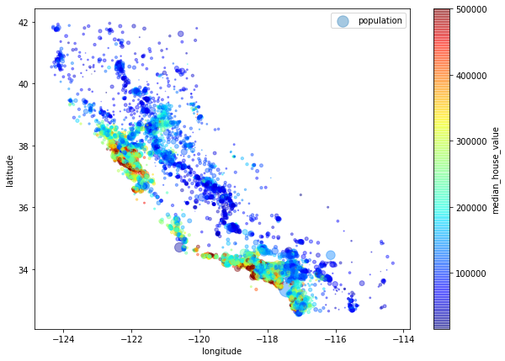
Discover and Visualize the Data

Slide 132
Discover and Visualize the Data
Observations?

Slide 133
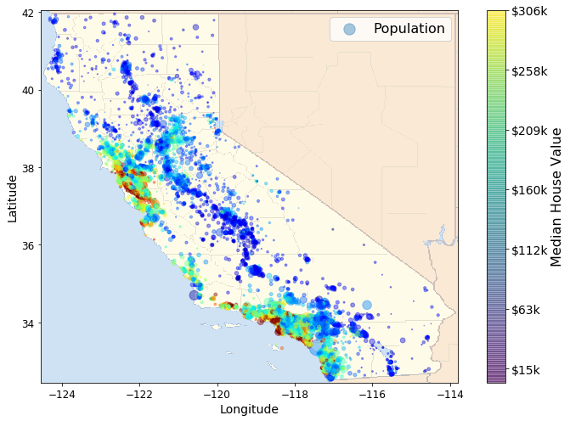
Discover and Visualize the Data

Slide 134
Discover and Visualize the Data
Observations
House prices are high
In the high density area
Closer to ocean

Slide 135
Discover and Visualize the Data
Observations
Now look at this

Slide 136
Discover and Visualize the Data

Slide 137
Discover and Visualize the Data
Observations
In Northern California the housing prices in coastal districts are not too high
So it is not a simple rule

Slide 138
Discover and Visualize the Data
Looking for Correlations
Correlation indicates
The extent to which two or more variables fluctuate together

Slide 139
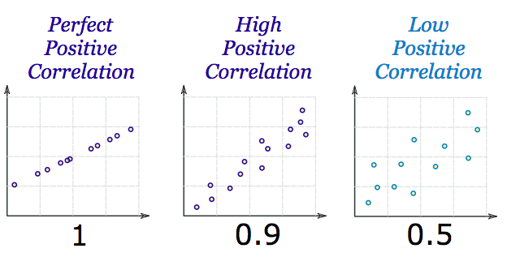
Discover and Visualize the Data
Positive Correlation
When the values increase together

Slide 140
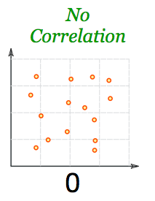
Discover and Visualize the Data
No Correlation
When values are not linked at all

Slide 141
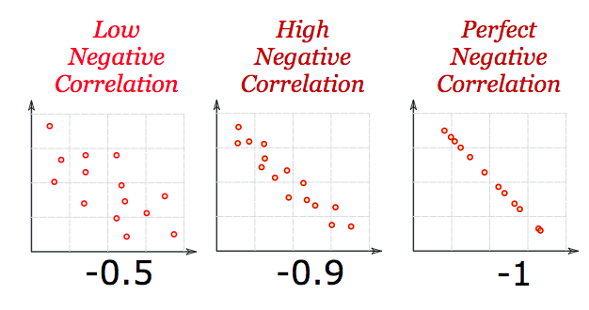
Discover and Visualize the Data
Negative Correlation
When one value decreases as the other increases

Slide 142
Discover and Visualize the Data
Looking for Correlations
Since the dataset is not too large
We can compute the correlations
Between every pair of attributes
Using corr() method

Slide 143
Discover and Visualize the Data
Correlations with the Median House Value
>>> corr_matrix = housing.corr()
>>> corr_matrix["median_house_value"].sort_values(ascending=False)
Run it in Notebook

Slide 144
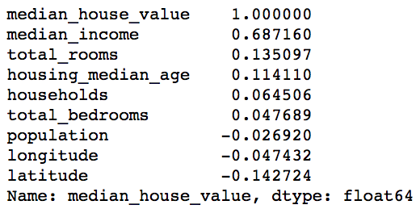
Discover and Visualize the Data
Correlations with the Median House Value
Positive Correlation
Median house value tends to go up when the median income goes up

Slide 145
Discover and Visualize the Data
Correlations with the Median House Value
Negative Correlation
Between the latitude and the median house value
Prices have a slight tendency to go down when you go north

Slide 146
Discover and Visualize the Data
Looking for Correlations - scatter_matrix
We can also look for correlations
Using Pandas’ scatter_matrix function
Plots every numerical attribute against every other numerical attribute

Slide 147
Discover and Visualize the Data
Looking for Correlations - scatter_matrix
Let’s look for correlation using scatter_matrix
We have eleven numerical attributes
We’ll get eleven by eleven plots (will not fit in page)

Slide 148
Discover and Visualize the Data
Looking for Correlations - scatter_matrix
Focus on attributes most correlated
median_house_value (target)
median_income
total_rooms
Housing_median_age
Note: On same x & y, Pandas decides it can give you more useful information, and plots the density plot of just that column of data.

Slide 149
Discover and Visualize the Data
Looking for Correlations - scatter_matrix
>>> from pandas.tools.plotting import scatter_matrix
>>> attributes = ["median_house_value", "median_income", "total_rooms", "housing_median_age"]
>>> scatter_matrix(housing[attributes], figsize=(12, 8))
Run it in Notebook

Slide 150
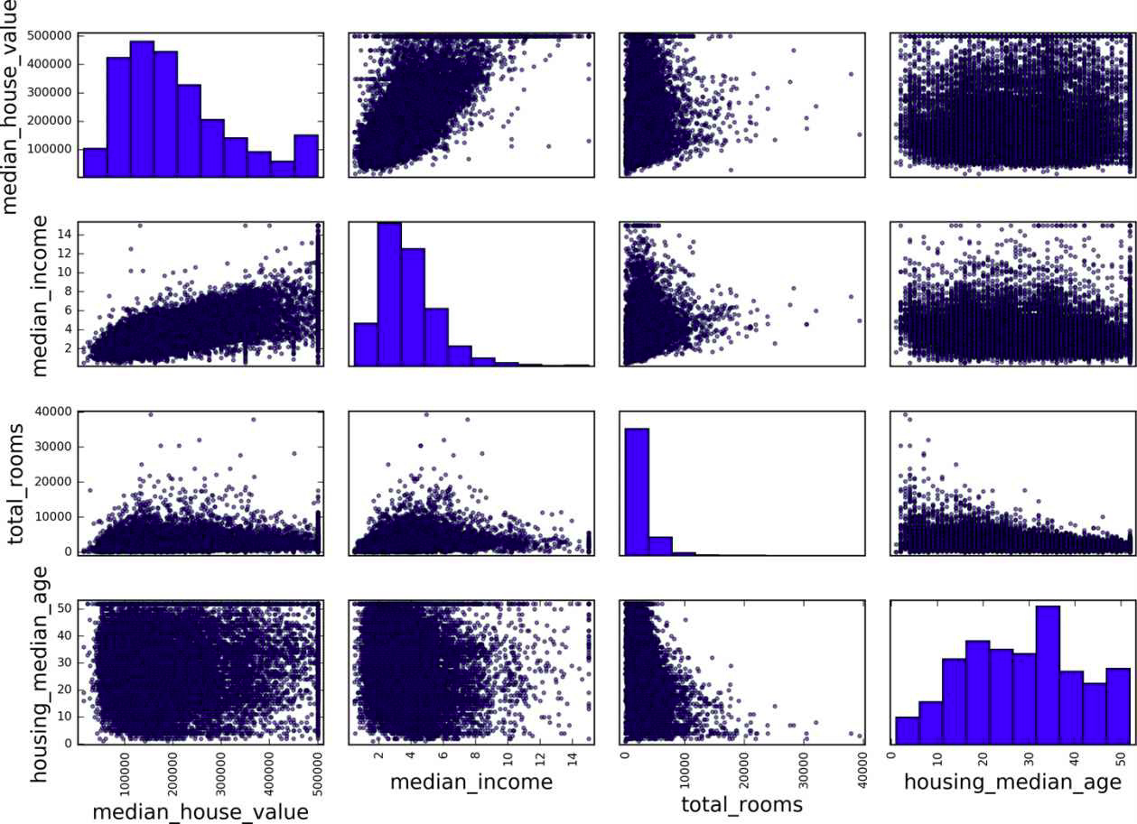
Discover and Visualize the Data
Notes:
Since plotting a value against itself is not interesting because it will always be a line, it plots the histogram.

Slide 151
Discover and Visualize the Data
Looking for Correlations - Most promising Attribute - Question
Which is the most promising attribute to predict median house value from the correlation plot?

Slide 152
Discover and Visualize the Data

Slide 153
Discover and Visualize the Data
Looking for Correlations - Most promising Attribute - Answer
Median income

Slide 154
Discover and Visualize the Data
Looking for Correlations - Most promising Attribute
Let’s zoom in to see correlation between median house value and median income
>>> housing.plot(kind="scatter", x="median_income", y="median_house_value", alpha=0.1)
>>> plt.axis([0, 16, 0, 550000])
Run it in Notebook

Slide 155
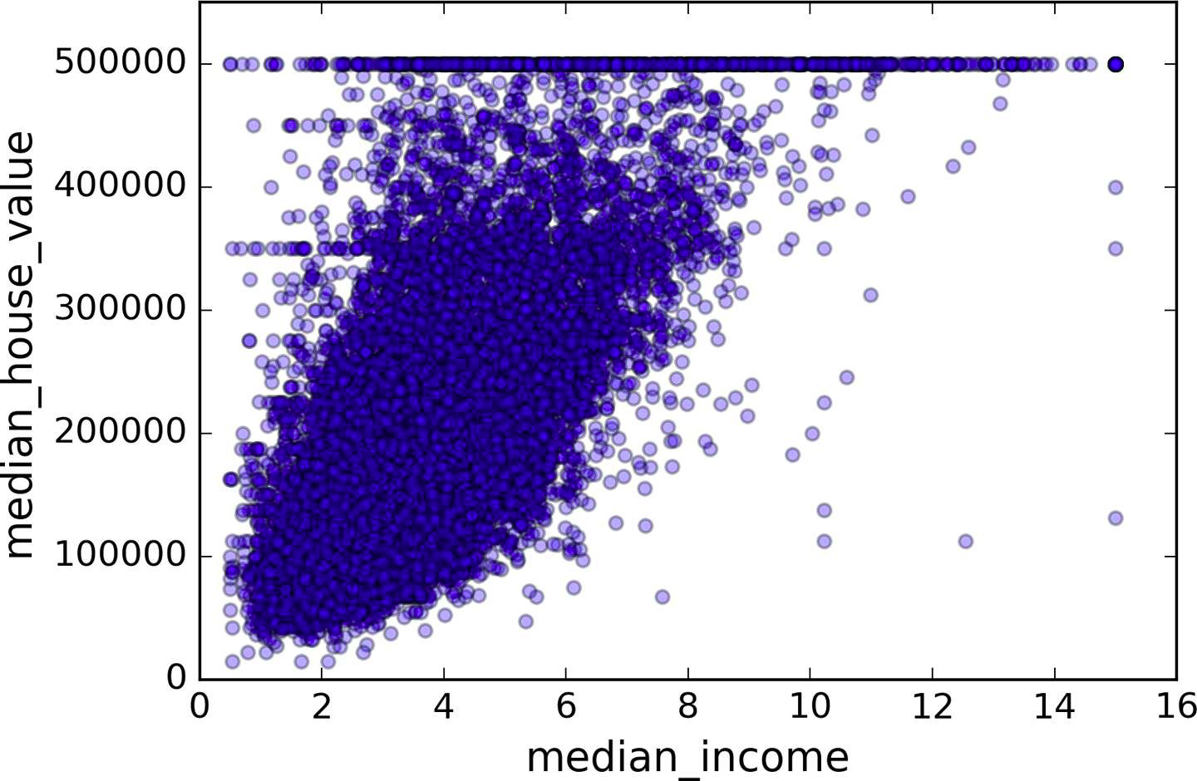
Discover and Visualize the Data
Looking for Correlations - Median House Value and Median Income

Slide 156
Discover and Visualize the Data
Observations??

Slide 157
Discover and Visualize the Data
Correlation is very strong

Slide 158
Discover and Visualize the Data
2. Price cap at $500, 000

Slide 159
Discover and Visualize the Data
3. Horizontal lines at $450, 000 & $350, 000 & $280,000

Slide 160
Discover and Visualize the Data
We should remove corresponding districts to prevent algorithm from learning to reproduce these data quirks

Slide 161
Discover and Visualize the Data
Experimenting with Attribute Combinations
Till now we have covered
Ways to explore data
And Gain insights
We’ve identified
Few data quirks - To be cleaned up before feeding the data to ML algorithm
Some attributes have a tail-heavy distribution

Slide 162
Discover and Visualize the Data
Experimenting with Attribute Combinations
Our mileage will vary with each project
But the general ideas are similar
We may want to try out various attribute combinations
Before preparing data for Machine Learning algorithms

Slide 163
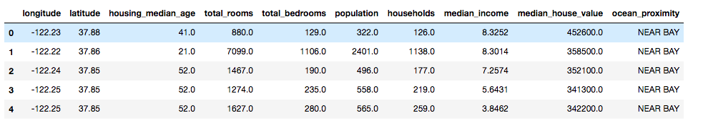
Discover and Visualize the Data
Experimenting with Attribute Combinations - Examples
The total number of rooms is not very useful
If we don’t know how many households there are
What about number of rooms per household

Slide 164
Discover and Visualize the Data
Experimenting with Attribute Combinations - Examples
The total number of bedrooms is not very useful
We want to compare it to
Number of bedrooms per room

Slide 165
Discover and Visualize the Data
Experimenting with Attribute Combinations - Examples
Population per household also seems an interesting attribute combination
Number of people per household

Slide 166
Discover and Visualize the Data
Experimenting with Attribute Combinations - Examples
Let’s create the new attributes
>>> housing["rooms_per_household"] = housing["total_rooms"]/housing["households"]
>>> housing["bedrooms_per_room"] = housing["total_bedrooms"]/housing["total_rooms"]
>>> housing["population_per_household"]=housing["population"]/housing["households"]
Run it in Notebook

Slide 167
Discover and Visualize the Data
Experimenting with Attribute Combinations - Examples
Let’s create correlation matrix again
>>> corr_matrix = housing.corr()
>>> corr_matrix["median_house_value"].sort_values(ascending=False)
Run it in Notebook

Slide 168
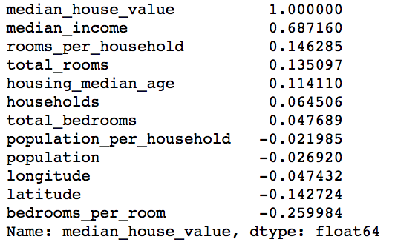
Discover and Visualize the Data
Experimenting with Attribute Combinations - Examples

Slide 169
Discover and Visualize the Data
Experimenting with Attribute Combinations - Examples

Slide 170
Checklist for Machine Learning Projects
Frame the problem and look at the big picture
Get the data
Explore the data to gain insights
Prepare the data for Machine Learning algorithms
Explore many different models and short-list the best ones
Fine-tune model
Present the solution
Launch, monitor, and maintain the system

Slide 171
Discover and Visualize the Data
Let’s prepare data for Machine Learning algorithms

Slide 172


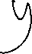






























Prepare the Data for ML Algorithms
Automate the Process
Let’s revert to a clean training set
Copy strat_train_set
Drop the target value from training set

Slide 173
Prepare the Data for ML Algorithms
Automate the Process
>>> housing = strat_train_set.drop("median_house_value", axis=1)
>>> housing_labels = strat_train_set["median_house_value"].copy()
Note- drop() creates a copy of the data and does not affect strat_train_set
Run it in Notebook

Slide 174
Prepare the Data for ML Algorithms
Data Cleaning

Slide 175
Prepare the Data for ML Algorithms
Data Cleaning
ML algorithms can not work with missing features
Create functions to take care of missing features

Slide 176

Prepare the Data for ML Algorithms
Data Cleaning - Missing Values
Already noticed that “total_bedrooms” has missing values
20640 - 20433 =
207 missing values

Slide 177
Prepare the Data for ML Algorithms
Data Cleaning - Missing Values - How to Fix?
Three options to fix this
Get rid of corresponding districts where total_bedroom has missing values
Get rid of the whole attribute
Set the values to some value (zero, the mean, the median, etc.)

Slide 178
Prepare the Data for ML Algorithms
Data Cleaning - Missing Values - DataFrame’s methods
We can fix missing values using DataFrame’s methods
dropna()
drop()
fillna()

Slide 179
Prepare the Data for ML Algorithms
Data Cleaning - Missing Values - Sample Dataset
Let’s experiment with these methods on sample dataset
>>> sample_incomplete_rows = housing[housing.isnull().any(axis=1)].head()
Run it in Notebook

Slide 180
Prepare the Data for ML Algorithms
Data Cleaning - Missing Values - Option One
dropna() - drops the missing values
>>> sample_incomplete_rows.dropna(subset=["total_bedrooms"])

Slide 181

Prepare the Data for ML Algorithms
Data Cleaning - Missing Values - Option Two
drop() - drops the attribute
>>> sample_incomplete_rows.drop(subset=["total_bedrooms"])
No total_bedrooms Attribute Now

Slide 182
Prepare the Data for ML Algorithms
Data Cleaning - Missing Values - Option Three
fillna() - sets the missing values
Let’s fill the missing values with the median
>>> median = housing["total_bedrooms"].median()
>>> sample_incomplete_rows["total_bedrooms"].fillna(median, inplace=True)
>>> sample_incomplete_rows
Run it in Notebook

Slide 183

Prepare the Data for ML Algorithms
Data Cleaning - Missing Values - Option Three
fillna() - sets the missing values

Slide 184
Prepare the Data for ML Algorithms
Data Cleaning - Missing Values
In the previous step
Save the computed median value
Later we need the saved median value in test set
While evaluating the system
Saved median value will also required
To replace missing values in the new data once we go live

Slide 185
Prepare the Data for ML Algorithms
Data Cleaning - Missing Values - Scikit-Learn SimpleImputer Class
Scikit-Learn provides SimpleImputer class
To take care of missing values
Create an instance of SimpleImputer class
Specify each attribute’s missing values
Should be replaced with the median of that attribute

Slide 186

Prepare the ata for ML Algorithms

Slide 187
Prepare the Data for ML Algorithms
Data Cleaning - Missing Values - Scikit-Learn SimpleImputer Class
Create an instance of SimpleImputer class
Define strategy as median
>>> from sklearn.impute import SimpleImputer
>>> imputer = SimpleImputer(strategy="median")

Slide 188
Prepare the Data for ML Algorithms
Data Cleaning - Missing Values - Scikit-Learn SimpleImputer Class
Median can be computed
Only on numerical attributes
Create copy of data
Without text attribute ocean_proximity
>>> housing_num = housing.drop("ocean_proximity", axis=1)

Slide 189
Prepare the Data for ML Algorithms
Data Cleaning - Missing Values - Fit the SimpleImputer Instance
Fit the SimpleImputer instance to the training data
Using the fit() method
>>> imputer.fit(housing_num)

Slide 190
Prepare the Data for ML Algorithms
Data Cleaning - Missing Values - Fit the SimpleImputer Instance
After calling fit()
SimpleImputer class computes the median of every attribute
And stores the computed medians in
statistics_ instance variable

Slide 191

Prepare the Data for ML Algorithms
Data Cleaning - Missing Values - Transform Training Set
Now let’s replace missing values in the training set
>>> X = imputer.transform(housing_num)
>>> X
Numpy array

Slide 192
Prepare the Data for ML Algorithms
Data Cleaning - Missing Values - Transform Training Set
Convert Numpy array to Pandas Dataframe
>>> housing_tr = pd.DataFrame(
X,
columns=housing_num.columns
)
>>> housing_tr.head()

Slide 193

Prepare the Data for ML Algorithms
Data Cleaning - Missing Values - Transformed Training Set
Transformed Training Set

Slide 194
Prepare the Data for ML Algorithms
Question - In the training set, only total_bedroom attribute was having missing values. Why did we transform the entire training set?

Slide 195
Prepare the Data for ML Algorithms
Answer
To be on the safer side
As new data may have missing values when system go live

Slide 196
Prepare the Data for ML Algorithms
Handling Text and Categorical Attributes

Slide 197
Prepare the Data for ML Algorithms
Handling Categorical Attributes
Most ML algorithms prefer to work with numbers
Let’s convert “ocean_proximity” attribute to numbers

Slide 198

Prepare the Data for ML Algorithms
Handling Categorical Attributes
>>> housing_cat = housing['ocean_proximity']
>>> housing_cat.head(10)

Slide 199
Prepare the Data for ML Algorithms
Example - Pandas’s factorize() Method
>>> df = pd.DataFrame({
'A':['type1','type3','type3', 'type2', 'type0']
})
>>> df['A'].factorize()
type1
type3
type3
type2
type0

Slide 200
Prepare the Data for ML Algorithms
Handling Categorical Attributes - Convert Text Labels to Numbers
>>> housing_cat_encoded, housing_categories = housing_cat.factorize()
>>> housing_cat_encoded[:10]
Output-
array([0, 0, 1, 2, 0, 2, 0, 2, 0, 0])

Slide 201
Prepare the Data for ML Algorithms
Handling Categorical Attributes - Pandas’s factorize() Method
Check Categories
>>> housing_categories
Output -
Index(['<1H OCEAN', 'NEAR OCEAN', 'INLAND', 'NEAR BAY', 'ISLAND'], dtype='object')

Slide 202
Prepare the Data for ML Algorithms
Handling Categorical Attributes
In the previous example,
Machine Learning algorithm may assume that
Two nearby values are more similar than
Two distant values
ML algo may assume that
0 and 1 are similar to each other as their distance is less
array([ 0 , 0 , 1 , 2 , 0 , 2 , 0 , 2 , 0 , 0 ])

Slide 203
Prepare the Data for ML Algorithms
Handling Categorical Attributes - One-Hot Encoding
To fix this,
A common solution is to create one binary attribute per category
Example
One attribute equal to
1 when the category is “<1H OCEAN”
and 0 otherwise
Another attribute equal to
1 when the category is “INLAND”
and 0 otherwise

Slide 204










Prepare the Data for ML Algorithms
Handling Categorical Attributes - One Hot Encoding
Sample Dataset One Hot Encoding
Only one attribute will be equal to 1 (hot), while the others will be 0 (cold)

Slide 205
Prepare the Data for ML Algorithms
Handling Categorical Attributes - OneHotEncoder
Scikit-Learn provides OneHotEncoder encoder to convert into one-hot vectors
Let’s encode the categories as one-hot vectors

Slide 206
Prepare the Data for ML Algorithms
Handling Categorical Attributes - OneHotEncoder
>>> from sklearn.preprocessing import OneHotEncoder
>>> encoder = OneHotEncoder()
>>> housing_cat_1hot = encoder.fit_transform(housing_cat)
>>> housing_cat_1hot
Output -

Slide 207

Prepare the Data for ML Algorithms
Handling Categorical Attributes - OneHotEncoder
OneHotEncoder returns a SciPy sparse array
We can convert it to a dense array if needed
>>> housing_cat_1hot.toarray()

Slide 208
Prepare the Data for ML Algorithms
Handling Categorical Attributes - Combining
Text Categories to Integer Categories
Integer Categories to One Hot Vectors
Use CategoricalEncoder to Combine the Two Operations

Slide 209
Prepare the Data for ML Algorithms
Handling Categorical Attributes - CategoricalEncoder
CategoricalEncoder combines the process of transforming
Text Categories to Integer Categories
Integer Categories to One Hot Vectors
We’ve defined the code for CategoricalEncoder in the notebook
This code will be shipped in Scikit-Learn in future releases
For now just go to Notebook and run it

Slide 210

Prepare the Data for ML Algorithms
Handling Categorical Attributes - CategoricalEncoder
>>> cat_encoder = CategoricalEncoder(encoding="onehot-dense")
>>> housing_cat_reshaped = housing_cat.values.reshape(-1, 1)
>>> housing_cat_1hot = cat_encoder.fit_transform(housing_cat_reshaped)
>>> housing_cat_1hot

Slide 211
Prepare the Data for ML Algorithms
Handling Categorical Attributes - CategoricalEncoder
>>> cat_encoder.categories_

Slide 212
Prepare the Data for ML Algorithms
Custom Transformers

Slide 213
Prepare the Data for ML Algorithms
Custom Transformers
We can write our own transformers for tasks such as
Custom cleanup operations or
Combining specific attributes

Slide 214
Prepare the Data for ML Algorithms
Custom Transformers
Scikit-Learn Pipeline class helps us in
Defining and Executing sequence of transformations
In the right order

Slide 215
Prepare the Data for ML Algorithms
How to Create Custom Transformers
Steps
Create a class
Implement three methods
fit()
transform()
fit_transform()
Or add TransformerMixin as a base class instead of fit_transform

Slide 216
Prepare the Data for ML Algorithms
How to Create Custom Transformers
Let’s create custom transformer for
Combining the attributes as we discussed earlier
rooms_per_household
population_per_household

Slide 217
Prepare the Data for ML Algorithms
Create Custom Transformers Class for Combining Attributes
Please see CombinedAttributesAdder class in the
notebook

Slide 218
Prepare the Data for ML Algorithms
Feature Scaling

Slide 219
Prepare the Data for ML Algorithms
Feature Scaling
Let’s observe the housing dataset once more
The total number of rooms ranges from about 6 to 39,320
While median incomes only range from 0 to 15
This is a problem

Slide 220
Prepare the Data for ML Algorithms
Feature Scaling
ML algorithms do not perform well
When the input numerical attributes
Have very different scales

Slide 221
Prepare the Data for ML Algorithms
Solution?

Slide 222
Prepare the Data for ML Algorithms
Feature Scaling
Feature Scaling is one of the most important
Transformation we need to apply to our data
Two ways to make sure all attributes have same scale
Min-max scaling
Standardization

Slide 223

Prepare the Data for ML Algorithms
Feature Scaling - Min-max Scaling
Also known as Normalization
Normalized values are in the range of [0, 1]

Slide 224

Prepare the Data for ML Algorithms
Feature Scaling - Min-max Scaling
Also known as Normalization
Normalized values are in the range of [0, 1]
Original Value
Normalized Value

Slide 225

Prepare the Data for ML Algorithms
Feature Scaling - Min-max Scaling - Example
# Creating DataFrame first
>>> import pandas as pd
>>> s1 = pd.Series([1, 2, 3, 4, 5, 6], index=(range(6)))
>>> s2 = pd.Series([10, 9, 8, 7, 6, 5], index=(range(6)))
>>> df = pd.DataFrame(s1, columns=['s1'])
>>> df['s2'] = s2
>>> df

Slide 226

Prepare the Data for ML Algorithms
Feature Scaling - Min-max Scaling - Example
# Use Scikit-Learn minmax_scaling
>>> from mlxtend.preprocessing import minmax_scaling
>>> minmax_scaling(df, columns=['s1', 's2'])
Original Scaled (In range of 0 and 1)

Slide 227
Prepare the Data for ML Algorithms
Feature Scaling - Standardization
In Machine Learning, we handle various types of data like
Audio signals and
Pixel values for image data
And this data can include multiple dimensions

Slide 228

Prepare the Data for ML Algorithms
Feature Scaling - Standardization
We scale the values by calculating
How many standard deviation is the value away from the mean
SAT scores ~ N(mean = 1500, SD = 300)
ACT scores ~ N(mean = 21, SD = 5)

Slide 229

Prepare the Data for ML Algorithms
Feature Scaling - Standardization
The general method of calculation
Calculate distribution mean and standard deviation for each feature
Subtract the mean from each feature
Divide the result from previous step of each feature by its standard deviation
Standardized Value

Slide 230

Prepare the Data for ML Algorithms
Feature Scaling - Standardization
In Standardization, features are rescaled
So that output will have the properties of
Standard normal distribution with
Zero mean and
Unit variance
Mean
Standard Deviation

Slide 231
Prepare the Data for ML Algorithms
Feature Scaling - Standardization
Scikit-Learn provides
StandardScaler class for standardization

Slide 232
Prepare the Data for ML Algorithms
Feature Scaling - Which One to Use?
Min-max scales in the range of [0,1]
Standardization does not bound values to a specific range
It may be problem for some algorithms
Example- Neural networks expect an input value ranging from 0 to 1
We’ll learn more use cases as we proceed in the course

Slide 233
Prepare the Data for ML Algorithms
Transformation Pipelines

Slide 234
Prepare the Data for ML Algorithms
Transformation Pipelines
As we can see that
We need many transformation steps to be executed in right order
We’ll use Scikit-Learn Pipeline class
For specifying sequence of transformations

Slide 235
Prepare the Data for ML Algorithms
Transformation Pipelines - Pipeline for Numerical Attributes
Let’s build a pipeline for the numerical attributes
Steps we have done so far
Handle missing values - SimpleImputer class with strategy as median
Custom transformer for combining attributes - CombinedAttributesAdder
Feature Scaling - StandardScaler

Slide 236
Prepare the Data for ML Algorithms
Transformation Pipelines - Pipeline for Numerical Attributes
Let’s build a pipeline for the numerical attributes
>>> from sklearn.pipeline import Pipeline
>>> from sklearn.preprocessing import StandardScaler
>>> num_pipeline = Pipeline([
('imputer', SimpleImputer(strategy="median")),
('attribs_adder', CombinedAttributesAdder()),
('std_scaler', StandardScaler()),
])
>>> housing_num_tr = num_pipeline.fit_transform(housing_num)

Slide 237
Prepare the Data for ML Algorithms
Transformation Pipelines - Pipeline for Numerical Attributes
The Pipeline constructor takes a list of name/estimator pairs defining a sequence of steps.
All but the last estimator must be transformers
num_pipeline = Pipeline([
('imputer', SimpleImputer(strategy="median")),
………………
………………
Name
Estimator

Slide 238
Prepare the Data for ML Algorithms
Transformation Pipelines
When we call the the pipeline’s fit() method
It calls fit_transform() sequentially on all transformers
Passing the output of each call as the parameter to the next transformer
Until it reaches the final estimator
For the final estimator it just calls the fit() method

Slide 239
Prepare the Data for ML Algorithms
Transformation Pipelines - DataFrameSelector
Scikit-Learn doesn't handle DataFrames
How to select columns from pipeline?
Let’s create a class DataFrameSelector
To select numerical or categorical columns

Slide 240
Prepare the Data for ML Algorithms
Transformation Pipelines - DataFrameSelector
class DataFrameSelector(BaseEstimator, TransformerMixin):
def __init__(self, attribute_names):
self.attribute_names = attribute_names
def fit(self, X, y=None):
return self
def transform(self, X):
return X[self.attribute_names].values

Slide 241
Prepare the Data for ML Algorithms
Transformation Pipelines - Pipeline for Numerical Attributes
So final pipeline for Numerical attributes looks like
>>> num_attribs = list(housing_num)
>>> num_pipeline = Pipeline([
('selector', DataFrameSelector(num_attribs)),
('imputer', SimpleImputer(strategy="median")),
('attribs_adder', CombinedAttributesAdder()),
('std_scaler', StandardScaler()),
])

Slide 242
Prepare the Data for ML Algorithms
Transformation Pipelines - Pipeline for Categorical Attributes
So final pipeline for categorical attributes looks like
>>> cat_attribs = ["ocean_proximity"]
>>> cat_pipeline = Pipeline([
('selector', DataFrameSelector(cat_attribs)),
('cat_encoder', CategoricalEncoder(encoding="onehot-dense")),
])

Slide 243
Prepare the Data for ML Algorithms
Transformation Pipelines - Full Pipeline
Let’s Combine the num_pipeline and cat_pipeline using Scikit-Learn FeatureUnion class
>>> from sklearn.pipeline import FeatureUnion
>>> full_pipeline = FeatureUnion(transformer_list=[
("num_pipeline", num_pipeline),
("cat_pipeline", cat_pipeline),
])

Slide 244
Prepare the Data for ML Algorithms
Transformation Pipelines - Full Pipeline
Each sub pipeline starts with a selector transformer
It simply transforms the data by selecting the desired attributes
While drops the rest
And converts the resulting DataFrame to a NumPy array

Slide 245

Prepare the Data for ML Algorithms
Transformation Pipelines - Run the Whole Pipeline
Run the whole pipeline
>>> housing_prepared = full_pipeline.fit_transform(housing)
>>> housing_prepared

Slide 246
Checklist for Machine Learning Projects
Frame the problem and look at the big picture
Get the data
Explore the data to gain insights
Prepare the data for Machine Learning algorithms
Explore many different models and short-list the best ones
Fine-tune model
Present the solution
Launch, monitor, and maintain the system

Slide 247
Train Models and Short-list Best Ones
Select and Train a Model

Slide 248
Train Models and Short-list Best Ones
Train a Model - Steps Done So Far
Framed the problem
Got data and explored it
Created training and test set
Transformation pipelines to
Clean up
Prepare data
Now we are ready to train the model

Slide 249
Train Models and Short-list Best Ones
Train a Model - Linear Regression
The goal of this step is to
Train few(two to five models) and
Select the best one
Let’s understand overfitting and underfitting before training a model

Slide 250
Train Models and Short-list Best Ones
What is Overfitting?
Say if you are visiting a foreign country
And the taxi driver rips you off
You might be tempted to say that
All taxi drivers in that country are thieves
Here we are overgeneralizing

Slide 251
Train Models and Short-list Best Ones
What is Overfitting?
Machines can also fall into this trap of overgeneralization like humans
This is called overfitting
In overfitting
The model performs well on the training data
But does not generalize well on unknown data

Slide 252
Train Models and Short-list Best Ones
When does overfitting occur?
Overfitting occurs when a machine learning algorithm captures the noise of the data.
Intuitively, overfitting occurs when the model or the algorithm fits the data too well.
Overfitting is often a result of an excessively complicated model,

Slide 253
Train Models and Short-list Best Ones
Let us consider an example of overfitting

Slide 254

Train Models and Short-list Best Ones
Overfitting Example
Here a high-degree polynomial strongly overfits the housing prices data. It performs much better on the training data than the simple linear model.

Slide 255
Train Models and Short-list Best Ones
Overfitting Example
But if the training set is noisy, then the model is likely to detect patterns in the noise itself and these patterns will not generalize to new instances.

Slide 256
Train Models and Short-list Best Ones
Understanding Overfitting
A complex model may detect patterns like the fact that all countries in the training data with a W in their name have a life satisfaction greater than 7:
New Zealand (7.3)
Norway (7.4)
Sweden (7.2)
Switzerland (7.5)

Slide 257
Train Models and Short-list Best Ones
Understanding Overfitting
If our model is trained on such countries than it will not generalize well for the following countries.
How confident are you that the W-satisfaction rule generalizes to
Rwanda ???
Zimbabwe ???

Slide 258
Train Models and Short-list Best Ones
Regularization - Tackling overfitting
Regularization can be one way in which we can tackle the problem of overfitting. In overfitting we -
Put constrain the model to make it simpler
The amount of regularization to apply during learning can be controlled by a hyperparameter

Slide 259
Train Models and Short-list Best Ones
Regularization - Tackling overfitting
Considering a linear model. It has two parameters, θ₀ and θ₁. It gives the learning algorithm two degrees of freedom to adapt the model to the training data:
It can tweak the height (θ₀)
Or the slope (θ₁) of the line

Slide 260
Train Models and Short-list Best Ones
Regularization - Tackling overfitting
If we forced θ₁ = 0, the algorithm would have only one degree of freedom
If we allow the algorithm to modify θ₁ then :
It will produce a simpler model than with two degrees of freedom
But it will be more complex than with just one degree of freedom

Slide 261

Train Models and Short-list Best Ones
Regularization - Tackling overfitting
The dotted line represents the original model that was trained with a few countries missing.

Slide 262
Train Models and Short-list Best Ones
Regularization - Tackling overfitting
The dashed line is our second model trained with all countries

Slide 263
Train Models and Short-list Best Ones
Regularization - Tackling overfitting
The solid line is a linear model trained with the same data as the first model but with a regularization constraint.

Slide 264
Train Models and Short-list Best Ones
Regularization - Tackling overfitting
Observations from the above example:
Regularization forced the model to have a smaller slope
Fits a bit less on the training data that the model was trained on
But actually allows it to generalize better to new examples.

Slide 265
Train Models and Short-list Best Ones
Regularization - Tackling overfitting
How do we choose the best model ???
When finding the best model, we’ll have to find the right balance between
Fitting the data perfectly
And keeping the model simple enough to ensure that it will generalize well

Slide 266
Train Models and Short-list Best Ones
What is Underfitting?
It occurs when your model is too simple to learn the underlying structure of the data. Underfitting is often a result of an excessively simple model.
For example, a linear model of life satisfaction is prone to underfit because reality is just more complex than the model, so it's predictions are bound to be inaccurate, even on the training examples.

Slide 267
Train Models and Short-list Best Ones
When does Underfitting occur ?
It happens when :
Features do not provide enough information to make good predictions
When the model or the algorithm does not fit the data well enough
Model is too simple

Slide 268

Train Models and Short-list Best Ones
Example of Underfitting
In the above plot the model doesn’t fit perfectly on the training data, hence it is a case of underfitting.

Slide 269
Train Models and Short-list Best Ones
How to solve the problem of Underfitting?
Select a more powerful model
Feed better features to training algorithm
Reduce the constraints on the model (e.g., reduce the regularization hyperparameter)

Slide 270
Train Models and Short-list Best Ones
Train a Model - Linear Regression
Let’s train the model now

Slide 271
Train Models and Short-list Best Ones
Train a Model - Linear Regression
>>> from sklearn.linear_model import LinearRegression
>>> lin_reg = LinearRegression()
>>> lin_reg.fit(housing_prepared, housing_labels)
Training Set Target Column

Slide 272
Train Models and Short-list Best Ones
Train a Model - Linear Regression
>>> from sklearn.linear_model import LinearRegression
>>> lin_reg = LinearRegression()
>>> lin_reg.fit(housing_prepared, housing_labels)
Training Set Target Column
Congrats! We’ve trained the first model :)

Slide 273
Train Models and Short-list Best Ones
Train a Model - Linear Regression
Let’s try the full pipeline on a few training instances
>>> some_data = housing.iloc[:5]
>>> some_labels = housing_labels.iloc[:5]
>>> some_data_prepared = full_pipeline.transform(some_data)
>>> print("Predictions:", lin_reg.predict(some_data_prepared))
>>> print("Actual values", list(some_labels))

Slide 274
Train Models and Short-list Best Ones
Train a Model - Linear Regression - Results
Actual | 286,600.0 | 340,600.0 | 196,900.0 | 46,300.0 | 254,500.0
Predicted | 210,644.6 | 317,768.8 | 210,956.4 | 59,218.9 | 189,747.5
% Error | -26.5 | -6.7 | 7.13 | 27.90 | -25.44

Slide 275
Train Models and Short-list Best Ones
Train a Model - Linear Regression - Observations
The predictions are not exactly accurate
The fourth prediction is off by more than 27%!

Slide 276
Train Models and Short-list Best Ones
Train a Model - Linear Regression - RMSE
Let’s find the regression model’s RMSE on the whole training set
Using Scikit-Learn’s mean_squared_error function

Slide 277
Train Models and Short-list Best Ones
Train a Model - Linear Regression - RMSE
>>> from sklearn.metrics import mean_squared_error
>>> housing_predictions = lin_reg.predict(housing_prepared)
>>> lin_mse = mean_squared_error(housing_labels, housing_predictions)
>>> lin_rmse = np.sqrt(lin_mse)
>>> lin_rmse
>>> 68628.413493824875

Slide 278
Train Models and Short-list Best Ones
Train a Model - Underfitting the Training Data
>>> lin_rmse
>>> 68628.413493824875
This is clearly not a great RMSE score
Most districts’ median_housing_values range
Between $120,000 and $265,000
So a typical prediction error of $68,628 is not very satisfying
This is example of
Model underfitting the training data

Slide 279
Train Models and Short-list Best Ones
Train a Model - Underfitting the Training Data
Solutions of Underfitting?
Select a more powerful model
Feed better features to training algorithm
Let’s train a DecisionTreeRegressor - Powerful model

Slide 280
Train Models and Short-list Best Ones
Train a Model - DecisionTreeRegressor
Capable of finding complex nonlinear relationships in the data
We will cover Decision Trees in details later in the course

Slide 281
Train Models and Short-list Best Ones
Train a Model - DecisionTreeRegressor
>>> from sklearn.tree import DecisionTreeRegressor
>>> tree_reg = DecisionTreeRegressor()
>>> tree_reg.fit(housing_prepared, housing_labels)

Slide 282
Train Models and Short-list Best Ones
Train a Model - DecisionTreeRegressor
Evaluate on the training set
>>> housing_predictions = tree_reg.predict(housing_prepared)
>>> tree_mse = mean_squared_error(housing_labels, housing_predictions)
>>> tree_rmse = np.sqrt(tree_mse)
>>> tree_rmse
Output - 0.0

Slide 283
Train Models and Short-list Best Ones
Train a Model - DecisionTreeRegressor
Evaluate on the training set
>>> housing_predictions = tree_reg.predict(housing_prepared)
>>> tree_mse = mean_squared_error(housing_labels, housing_predictions)
>>> tree_rmse = np.sqrt(tree_mse)
>>> tree_rmse
Output - 0.0
Really ???

Slide 284
Train Models and Short-list Best Ones
Train a Model - Overfitting the Training Data
Could this model really be absolutely perfect?
This is called overfitting the training data
Let’s evaluate the previous DecisionTreeRegressor model
Using Cross-Validation

Slide 285
Train Models and Short-list Best Ones
Better Evaluation Using Cross-Validation

Slide 286
Train Models and Short-list Best Ones
We should not touch the test set until
We are confident about the model on training set

Slide 287
Train Models and Short-list Best Ones
We should not not touch the test set until
We are confident about the model on training set
Then how should we validate the model?

Slide 288
Train Models and Short-list Best Ones
We should not not touch the test set until
We are confident about the model on training set
Then how should we validate the model?
Answer - Using Cross-Validation

Slide 289
Train Models and Short-list Best Ones
Cross-Validation
In cross-validation we use
Part of the training set for training
And part for model validation

Slide 290
Train Models and Short-list Best Ones
Cross-Validation
Original Dataset
Training Set
Test Set
Divide Training Set in Two Parts
Smaller Training Set
Validation Set
For Training the Model
For Evaluating the Model

Slide 291

N-fold
Performance measure - Cross Validation
Here k = 10

Slide 292
Train Models and Short-list Best Ones
Cross-Validation
Use the Scikit-Learn’s train_test_split function to split
Training set into a smaller
Training set and
Validation set
Train models against the
Smaller training set and
Evaluate them against validation set

Slide 293
Train Models and Short-list Best Ones
Cross-Validation
We can also use Scikit-Learn’s cross-validation feature

Slide 294
Train Models and Short-list Best Ones
Cross-Validation - K-fold - DecisionTreeRegressor
We can also use Scikit-Learn’s cross-validation feature
>>> from sklearn.model_selection import cross_val_score
>>> scores = cross_val_score(tree_reg, housing_prepared, housing_labels, scoring="neg_mean_squared_error", cv=10)
>>> tree_rmse_scores = np.sqrt(-scores)
K-fold Cross-Validation
10 folds

Slide 295
Train Models and Short-list Best Ones
Cross-Validation - K-fold
Previous code performs K-fold cross-validation
It randomly splits the training set into
10 distinct subsets called folds
Then it trains and evaluates the Decision Tree model 10 times
Picking a different fold for evaluation every time
And training on the other 9 folds
The result is an array containing the 10 evaluation scores

Slide 296
Train Models and Short-list Best Ones
Cross-Validation - K-fold - DecisionTreeRegressor - Output
>>> def display_scores(scores):
print("Scores:", scores)
print("Mean:", scores.mean())
print("Standard deviation:", scores.std())
>>> display_scores(tree_rmse_scores)
Scores: [ 70232.0136482 66828.46839892 72444.08721003 70761.50186201 71125.52697653 75581.29319857 70169.59286164 70055.37863456 75370.49116773 71222.39081244]
Mean: 71379.0744771
Standard deviation: 2458.31882043

Slide 297
Train Models and Short-list Best Ones
Cross-Validation - K-fold - Linear Regression
Now compute the same score for Linear Regression
>>> lin_scores = cross_val_score(lin_reg, housing_prepared, housing_labels, scoring="neg_mean_squared_error", cv=10)
>>> lin_rmse_scores = np.sqrt(-lin_scores)
>>> display_scores(lin_rmse_scores)
Scores: [ 66782.73843989 66960.118071 70347.95244419 74739.57052552 68031.13388938 71193.84183426 64969.63056405 68281.61137997 71552.91566558 67665.10082067]
Mean: 69052.4613635
Standard deviation: 2731.6740018

Slide 298
Train Models and Short-list Best Ones
Cross-Validation - K-fold - Linear Regression Vs Decision Tree
Linear Regression
Mean:
69, 052.4613635
Standard deviation:
2, 731.6740018
DecisionTreeRegressor
Mean:
71, 379.0744771
Standard deviation:
2, 458.31882043

Slide 299
Train Models and Short-list Best Ones
Cross-Validation - K-fold - Linear Regression Vs Decision Tree
Linear Regression
Mean:
69, 052.4613635
Standard deviation:
2, 731.6740018
DecisionTreeRegressor
Mean:
71, 379.0744771
Standard deviation:
2, 458.31882043
Decision Tree model performed worse than the Linear Regression model. Decision Tree model is overfitting when RMSE came to 0.0

Slide 300
Train Models and Short-list Best Ones
Cross-Validation - K-fold - Important points
Cross-validation gives
Estimate of the performance of your model and
Also a measure of how precise this estimate
The Decision Tree has a score of
Approximately 71, 379
With precision of ± 2, 458 (Standard Deviation)

Slide 301
Train Models and Short-list Best Ones
RandomForestRegressor
Let’s train our last model
RandomForestRegressor
Random Forests work by training many Decision Trees
On random subsets of the features
Then averaging out their predictions
We will cover Random Forests in details later in the course

Slide 302
Train Models and Short-list Best Ones
RandomForestRegressor - RMSE
Let’s train our last model using Random Forests
>>> from sklearn.ensemble import RandomForestRegressor
>>> forest_reg = RandomForestRegressor(random_state=42)
>>> forest_reg.fit(housing_prepared, housing_labels)
>>> housing_predictions = forest_reg.predict(housing_prepared)
>>> forest_mse = mean_squared_error(housing_labels, housing_predictions)
>>> forest_rmse = np.sqrt(forest_mse)
Output - 21941.911027380233

Slide 303
Train Models and Short-list Best Ones
RandomForestRegressor - Using Cross-Validation
Let’s train Random Forests using cross-validation
>>> from sklearn.model_selection import cross_val_score
>>> forest_scores = cross_val_score(forest_reg, housing_prepared, housing_labes, scoring="neg_mean_squared_error", cv=10)
>>> forest_rmse_scores = np.sqrt(-forest_scores)

Slide 304
Train Models and Short-list Best Ones
RandomForestRegressor - Using Cross-Validation
Let’s train Random Forests using cross-validation
>> display_scores(forest_rmse_scores)
Scores: [ 51650.94405471 48920.80645498 52979.16096752 54412.74042021 50861.29381163 56488.55699727 51866.90120786 49752.24599537 55399.50713191 53309.74548294]
Mean: 52564.1902524
Standard deviation: 2301.87380392

Slide 305
Train Models and Short-list Best Ones
Training Models Comparison
Linear Regression
Mean - 69, 052
SD - 2, 731
Decision
Tree
Mean - 71, 379
SD - 2, 458
Random
Forest
Mean - 52, 564
SD - 2, 301
SD - Standard Deviation
Random Forests perform lot better

Slide 306
Train Models and Short-list Best Ones
Explore More Models
Till now we have explored few models
Now the goal is to shortlist
A few (two to five) promising models

Slide 307
Checklist for Machine Learning Projects
Frame the problem and look at the big picture
Get the data
Explore the data to gain insights
Prepare the data for Machine Learning algorithms
Explore many different models and short-list the best ones
Fine-tune model
Present the solution
Launch, monitor, and maintain the system

Slide 308
Fine-tune Model
Fine-Tune Your Model

Slide 309
Fine-tune Model
Fine-Tune Model
This section is to help you understand various fine-tuning methods
It’s okay
If you do not understand the code, terms and concepts at this moment
We will cover the concepts and code in details as we progress in the course

Slide 310
Fine-tune Model
Fine-Tune Model
Now we have two to five promising models
Let’s fine-tune them

Slide 311
Fine-tune Model
Fine-Tune Model
Now we have two to five promising models
Let’s fine-tune them
How do we fine-tune?

Slide 312
Fine-tune Model
Fine-Tune Model - Hyperparameters
Before learning about how to fine-tune the models
Let’s learn about Hyperparameters first

Slide 313
Fine-tune Model
What are Hyperparameters?
A machine learning model is a mathematical formula
With a number of parameters that need to be learned from the data
The soul of machine learning is
Fitting a model to the data
By training a model with existing data
We fit the model parameters

Slide 314
Fine-tune Model
What are Hyperparameters?
There is another kind of parameters
That cannot be directly learned from the model training process
These parameters express
Higher-level properties of the model such as
Its complexity or
How fast it should learn

Slide 315
Fine-tune Model
What are Hyperparameters?
These parameters are called Hyperparameters
Hyperparameters are usually decided before the actual training begins
Can be decided by
Setting different values
Training different models and
Choosing the values that work best

Slide 316
Fine-tune Model
Some examples of Hyperparameters?
Number of leaves or depth of a tree
Learning rate
How fast a model should learn
Number of hidden layers in a deep neural network
Number of clusters in a k-means clustering

Slide 317
Fine-tune Model
Fine-Tune Model - Solutions
Now let’s learn how to fine-tune models

Slide 318
Fine-tune Model
Fine-Tune Model - Solutions
One solution is to fiddle with the hyperparameters manually
Until we find a great combination of hyperparameter values
This is very tedious work
And we may not have time to explore many combinations

Slide 319
Fine-tune Model
Grid Search

Slide 320
Fine-tune Model
Fine-Tune Model - Grid Search
Evaluates all possible combinations of hyperparameters values
Using cross-validation
All we need to tell
Which hyperparameters we want it to experiment with and
What values to try out
We will cover Grid Search in details later in the course

Slide 321
Fine-tune Model
Fine-Tune Model - Grid Search - Example
Following code searches for the best possible combination of hyperparameter values for RandomForestRegressor

Slide 322
Fine-tune Model
Fine-Tune Model - Grid Search - Example
>>> from sklearn.model_selection import GridSearchCV
>>> param_grid = [
{'n_estimators': [3, 10, 30], 'max_features': [2, 4, 6, 8]},
{'bootstrap': [False], 'n_estimators': [3, 10], 'max_features':[2, 3, 4]
},
]
>>> forest_reg = RandomForestRegressor()
>>> grid_search = GridSearchCV(forest_reg, param_grid, cv=5, scoring='neg_mean_squared_error')
>>> grid_search.fit(housing_prepared, housing_labels)
Run it in Notebook

Slide 323
Fine-tune Model
Fine-Tune Model - Grid Search - Example
Get the best combination of parameters (We will cover this later in the course)
>>> grid_search.best_params_
Output-
{'max_features': 8, 'n_estimators': 30}

Slide 324
Fine-tune Model
Fine-Tune Model - Grid Search - Example
Get the best estimator (We will cover this later in the course)
>>> grid_search.best_estimator_
Output-
RandomForestRegressor(bootstrap=True, criterion='mse', max_depth=None,
max_features=8, max_leaf_nodes=None,
min_impurity_decrease=0.0, min_impurity_split=None, min_samples_leaf=1, min_samples_split=2, min_weight_fraction_leaf=0.0, n_estimators=30,
n_jobs=1, oob_score=False, random_state=42,
verbose=0, warm_start=False
)

Slide 325
Fine-tune Model
Fine-Tune Model - Grid Search - Example
Get the score of each hyperparameter combination tested during the grid search (We will cover this later in the course)
>>> cvres = grid_search.cv_results_
>>> for mean_score, params in zip(cvres["mean_test_score"], cvres["params"]):
print(np.sqrt(-mean_score), params)

Slide 326
Fine-tune Model
Randomized Search

Slide 327
Fine-tune Model
Fine-Tune Model - Randomized Search
The grid search approach is fine
When you are exploring relatively few combinations
When the hyperparameter search space is large, use RandomizedSearchCV
We will cover Randomized Search in details later in the course

Slide 328
Fine-tune Model
Fine-Tune Model - Randomized Search
Randomized search
Instead of trying out all possible combinations
Evaluates a given number of random combinations
By selecting a random value for each hyperparameter
At every iteration

Slide 329
Fine-tune Model
Fine-Tune Model - Randomized Search
Has two main benefits
One
Say our randomized search runs for 1000 iterations
It will explore 1,000 different values for each hyperparameter
While Grid Search explores few values per hyperparameter

Slide 330
Fine-tune Model
Fine-Tune Model - Randomized Search
Has two main benefits
Two
We have more control over the computing budget we want to allocate to hyperparameter search
Simply by setting the number of iterations

Slide 331
Fine-tune Model
Fine-Tune Model - Randomized Search
Check the RandomizedSearchCV code in Notebook

Slide 332
Fine-tune Model
Ensemble Methods

Slide 333
Fine-tune Model
Fine-Tune Model - Ensemble Methods
Another way of fine-tuning models is to
Combine best performing models
The ensemble(group)
Oftens perform better than the
Best individual model
Just like in previous example
Random forests performed better than the
Individual decision trees

Slide 334
Fine-tune Model
Analyze the Best Models and Their Errors

Slide 335
Fine-tune Model
Analyze the Best Models
Let’s see the importance score of each attribute
>>> feature_importances = grid_search.best_estimator_.feature_importances_
>>> extra_attribs = ["rooms_per_hhold", "pop_per_hhold", "bedrooms_per_room"]
>>> cat_encoder = cat_pipeline.named_steps["cat_encoder"]
>>> cat_one_hot_attribs = list(cat_encoder.categories_[0])
>>> attributes = num_attribs + extra_attribs + cat_one_hot_attribs
>>> sorted(zip(feature_importances, attributes), reverse=True)

Slide 336

Fine-tune Model
Analyze the Best Models
Observations??

Slide 337
Fine-tune Model
Evaluate model on the Test Set

Slide 338
Fine-tune Model
Evaluate Model on Test Set
After tweaking the models for a while
When we are confident about the model
Then evaluate the model on the test set

Slide 339
Fine-tune Model
Evaluate Model on Test Set - Process
Get the final model

Slide 340
Fine-tune Model
Evaluate Model on Test Set - Process
Get the final model
>>> final_model = grid_search.best_estimator_

Slide 341
Fine-tune Model
Evaluate Model on Test Set - Process
2. Get predictors and labels from test set
# Predictors
>>> X_test = strat_test_set.drop("median_house_value", axis=1)
# Labels
>>> y_test = strat_test_set["median_house_value"].copy()

Slide 342
Fine-tune Model
Evaluate Model on Test Set - Process
3. Run full_pipeline to transform the data
>>> X_test_prepared = full_pipeline.transform(X_test)

Slide 343
Fine-tune Model
Evaluate Model on Test Set - Process
4. Evaluate the final model on the test set
# Predictions on Test set
>>> final_predictions = final_model.predict(X_test_prepared)
# Calculate final RMSE
>>> final_mse = mean_squared_error(y_test, final_predictions)
>>> final_rmse = np.sqrt(final_mse)

Slide 344
Fine-tune Model
Evaluate Model on Test Set - Process
4. Evaluate the final model on the test set
>>> final_rmse = final_model.predict(X_test_prepared)
Output-
47,766.0039

Slide 345
Fine-tune Model
Congratulation! We have trained and tested our first model :)

Slide 346
Fine-tune Model
Evaluate Model on Test Set
This model is not perfect though
We’ll learn more ways to build better models as we progress in the course

Slide 347
Fine-tune Model
Evaluate Model on Test Set - Summary
If we do lot of hyperparameters tuning than the
Performance of the model will be worse than the
Performance measured in cross-validation
This happens because
The model is fine-tuned to perform well on the validation data
And performs badly on unknown datasets

Slide 348
Fine-tune Model
Evaluate Model on Test Set - Summary
We must resist the temptation to tweak hyperparameters to look good on test set
As model will not generalize to new data

Slide 349
Checklist for Machine Learning Projects
Frame the problem and look at the big picture
Get the data
Explore the data to gain insights
Prepare the data for Machine Learning algorithms
Explore many different models and short-list the best ones
Fine-tune model
Present the solution
Launch, monitor, and maintain the system

Slide 350
Present the Solution
Pre Launch Phase

Slide 351
Present the Solution
Pre Launch Phase
Now we need to present the solution
What have we learned
What worked and what did not
What assumptions were made
What are model’s limitations

Slide 352
Present the Solution
Pre Launch Phase
Document everything
Create nice presentations
With clear visualizations

Slide 353
Checklist for Machine Learning Projects
Frame the problem and look at the big picture
Get the data
Explore the data to gain insights
Prepare the data for Machine Learning algorithms
Explore many different models and short-list the best ones
Fine-tune model
Present the solution
Launch, monitor, and maintain the system

Slide 354
Launch, Monitor and Maintain the system
Launch the System

Slide 355
Launch, Monitor and Maintain the system
Prepare the solution for production
Plugging the production input data sources

Slide 356
Launch, Monitor and Maintain the system
Monitor the System

Slide 357
Launch, Monitor and Maintain the system
Monitor the System
Write monitoring code to check
Model’s live performance at regular intervals
Trigger alerts when it drops
Important to catch performance degradation
As models tends to rot
If not trained on fresh data

Slide 358
Launch, Monitor and Maintain the system
Plug Human Evaluation Pipeline into System
Sample the model’s predictions and evaluate them from time to time
This generally requires a human analysis
These analysts may be
Field experts or
Workers on a crowdsourcing platform such as
Amazon Mechanical Turk
CrowdFlower

Slide 359
Launch, Monitor and Maintain the system
Evaluate the Input Data Quality
Evaluate the model’s input data quality from time to time
Performance may degrade if the input data quality is not good
For example, malfunction sensors sending random values
Monitoring input data quality is
Especially important for online learning systems

Slide 360
Launch, Monitor and Maintain the system
Maintain the System

Slide 361
Launch, Monitor and Maintain the system
Maintain the System
Train model on a regular basis using fresh data
Automate the process of regularly updating of training model with fresh data
Else system’s performance may fluctuate severely over time
For an online learning system
Make sure to save snapshots of its state at regular intervals
So that we can easily roll back to a previously working state

Slide 362
Summary

Slide 363


Slide 364
Summary
As we can see, much of the work is in the
Data preparation step
Deploying
Building monitoring tools
Setting up human evaluation pipelines and
Automating regular model training

Slide 365
Summary
Be comfortable with the overall process
Know three or four algorithms
Rather than to spend all your time exploring advanced algorithms
And not spending enough time on the overall process
Spend enough time on the overall process

Slide 366
Summary
In this chapter we learnt about
Statistical Inference, Probability and Measures of Central Tendency
Creating a Machine Learning Model
Getting the data
Exploring the data
Splitting our data into Train and Test set
Exploring different models and choosing the best one
Fine Tuning our model
Presenting the solution

Slide 367
Summary
In this course we learnt about
3. Stratified Sampling using Scikit learn
4. Visualizing our dataset
5. Looking for Correlations in the data
6. Data Cleaning
7. Training a model using Scikit learn

Slide 368
Questions?
https://discuss.cloudxlab.com
reachus@cloudxlab.com

